Slide 1

Information Sharing Implementation Training
For Hospitals and Integrated Health Services

Slide 2
Acknowledgments
Notes:
Include Acknowledgement of relevant Country.
Include acknowledgment statement for victim survivors.

Slide 3



Key Support Services
1800 737 732
1800 271 045
Information Sharing and MARAM enquiry line:
1800 015 188
1800 549 646

Slide 4

Group Introduction
Name
Role
Hospital / Integrated Health Service
Knowledge and experience of Information Sharing Schemes (training, current or previous involvement)
Photo by Mohamed Nohassi on Unsplash

Slide 5
Group Agreement
Permission for facilitators to move the group along
All of us
How
People that we work with
Now and after the session
Acknowledging diverse experiences
Moving up – moving down
Challenging the ideas not the people
Active Listening
Privacy and Confidentiality
Respectful Interaction
Self-Care
Participation
Active participation
Attitude of curiosity
The right to pass
Permission to make mistake
Individual strategies
As a group

Slide 6
Training Overview
I. Refresher & the Guide
Overview of the ISS Guide
MARAM & Information Sharing Schemes (ISS),FVISS & CISS
II. Implementation
Checklist
Implementation Plan
III. Practice Examples
Case Studies
Gaps and challenges
Collaboration
Prerequisite:
1. Completed ISS eLearn (DOH)
2. Familiar with the ISS Guide (SHRFV)
Notes:
Structure of the session including the breaks
Target audience
Prerequisite
1. Completed ISS eLearn (DOH)
2. Familiar with the ISS Guide (SHRFV)
What it covers and does not cover

Slide 7

Learning Objectives
A refresher of the Victorian reforms and their intersections with relevant Family Violence legislation
An understanding of key tasks (assessing how ISS has been embedded within your health service, review and update implementation plan, and evaluating its success) to lead the organisational implementation of the FVISS and CISS in the context of the MARAM framework
An awareness of existing gaps and challenges related to implementation and embedding of ISS, and brainstorming solutions

Slide 8
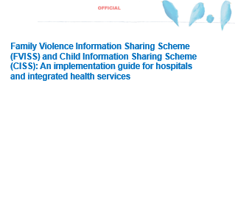
An Implementation Guide for Hospitals and Integrated Health Services
Background: The Information Sharing Schemes
A proposed checklist to monitor and evaluate how the Information Schemes have been embedded
Guide to Sharing Information under the Information Sharing Schemes
Documentation
Appendices
  Relative legislation and overview
  Resources
  Example case studies
  Glossary of terms
Notes:
Family Violence Information Sharing Scheme (FVISS) and Child Information Sharing Scheme (CISS): An implementation guide for hospitals and integrated health services is designed to assist public hospitals and integrated health services to ensure they have the appropriate systems to safely and ethically implement FVISS and CISS (‘Information Sharing Schemes’ or ‘Schemes’) and to share information under the Schemes. It suggests processes that could support your services’ implementation of the Schemes in a step by step approach.
It includes:
An Introduction
Background on the Information Sharing Schemes
A checklist to prepare for application of the Schemes
Guide to sharing under the Information Sharing Schemes
Documentation
Relevant legislation and overview (Appendix 1)
Examples of resources (Appendix 2)
Examples of case studies for staff training (Appendix 3)

Slide 9
Refresher and the Guide

Slide 10

Why Sharing Information?
Photo by Jon Tyson on Unsplash
Notes:
MARAM framework and information sharing schemes have been found to have improved collaboration within and across sectors overall.
Timely, voluntary, ‘proactive’ information sharing helps services to work with victim survivors in a trauma and violence informed manner to assess risk and prepare safety plans that are relevant to their evolving needs.
Proactive sharing information moves the focus from victim survivors being responsible for their own safety, to a shared accountability between victim survivors and the broader service system in both managing victim survivor safety and holding perpetrators of family violence to account.
Sharing information under FVISS and CISS helps to:
Promote the safety of victim survivors and their families
Hold perpetrators of family violence to account
Prioritise the broader wellbeing and safety needs of children.

Slide 11
‘Information sharing allows organisations to work together to assess & manage safety, reduce the burden on victim survivors, and promote child wellbeing.’
State Government of Victoria 2020
Notes:
State Government of Victoria. (2020). Tips for a conversation with a child and/or their parent about information sharing. https://www.vic.gov.au/tips-conversation-child-and-or-their-parent-about-information-sharing

Slide 12
Interrelated Reform in Victoria and Their Objectives
Child Information Sharing Scheme (Part 6A Child Wellbeing and Safety Act 2005)
Family Violence Information Sharing Scheme (Part 5A Family Violence Protection Act 2008)
Multi Agency Risk Assessment and Management Framework (Part 11 Family Violence Protection Act 2008)
Notes:
Key public health services are legally prescribed to share information on family violence under Victoria's Family Violence Protection Act 2008 (FVPA), and to share information to promote child wellbeing and safety under Victoria's Child Wellbeing and Safety Act. That means that from 19 April 2021 the Child Information Sharing Scheme (CISS), the Family Violence Information Sharing Scheme (FVISS) and Multi-Agency Risk Assessment and Management Framework (MARAM) commenced for health and hospital services, as funded organisations in Phase 2 of prescription to the reforms:
• Child Information Sharing Scheme (Part 6A Child Wellbeing and Safety Act 2005)
• Family Violence Information Sharing Scheme (Part 5A Family Violence Protection Act 2008)
• Multi Agency Risk Assessment and Management Framework (Part 11 Family Violence Protection Act 2008)
Since then, the Royal Commission into Family Violence emphasised, in its 2016 report, that services need to share family violence information as part of their collaborative practice. The report found this was necessary to keep the victim survivor safe and the perpetrator in view of the public system and accountable to the community. The McClellan Royal Commission into Institutional Responses to Child Sexual Abuse (2017) also identified that the lack of information sharing had contributed to negative outcomes for the wellbeing and safety of Victorian children.
These inquiries have shown that integrated and timely provision of service and access to information is essential in:
promoting the safety of victim survivors and their families
holding perpetrators of family violence to account
the broader wellbeing and safety needs of children.

Slide 13

Why Share Information
Notes:
Large group Activity
Answers may include:
Raises Awareness and Understanding
Empowers Victims and Survivors
Improves Early Intervention
Builds a Stronger Support Network
Informs Policy and Advocacy
Encourages Community Involvement
Reduces Risk and Harm

Slide 14
Terminology Refresher
FVISS
CISS
FOI
AUFV / Alleged AUFV
Reasonable Belief
ISE
&
RAE
Third party
Notes:
Information Sharing Schemes:
Term used to reference both the Family Violence Information Sharing Scheme (FVISS) and the Child Information Sharing Scheme (CISS)
FVISS:
Family Violence Information Sharing Scheme enables the sharing of information between authorised organisations to assess and manage family violence risk.
CISS:
Child Information Sharing Scheme enables information sharing between authorised organisations to promote a child's wellbeing or safety
Child:
A person who is under 18 years of age
FOI:
Freedom Of Information provides an individual the right to request access to person and health documents held by a health service
Adult Using Family Violence/Alleged Adult Using Family Violence:
A person where there is reasonable belief they are a user of family violence, or they are alleged/there is suspicion they pose a risk of committing family violence.
Reasonable Belief: An opinion which is formed based on observation and information from reliable and credible sources. Reasonable belief in this context is there is a reasonable basis to believe that family violence is occurring based on observations and information.
ISE:
Information Sharing Entity as prescribed under CISS and or FVISS
(NB: public hospitals and integrated health services are prescribed as Information Sharing Entities under the Information Sharing Schemes)
RAE:
Risk Assessment Entity – a subset of ISEs and may request information for a family violence assessment purpose under FVISS
Third Party:
Any person whose confidential information is relevant to assessing or managing family violence risk but is not the AUFV/alleged AUFV or victim survivor (adult or child).
Other key terms:
Hospitals and integrated health services:
Refers to public hospitals and integrated health services that are prescribed as an Information Sharing Entity under the Information Sharing Schemes
MARAM:
Multi-Agency Risk Assessment and Management Framework
Staff delegates:
Staff who have been nominated and authorised internally by the organisation to make decisions relating to the disclosures of information under FVISS and CISS.
Diverse communities
In line with MARAM framework, diverse communities refer to the following groups: diverse cultural, linguistic and faith communities; people living with a disability; people experiencing mental health issues; lesbian, gay, bisexual, trans and gender diverse, intersex and queer/questioning (LGBTIQ) people; women in or exiting prison or forensic institutions; people who work in the sex industry; people living in regional, remote and rural communities; male victims; older people and young people (12–25 years of age).

Slide 15
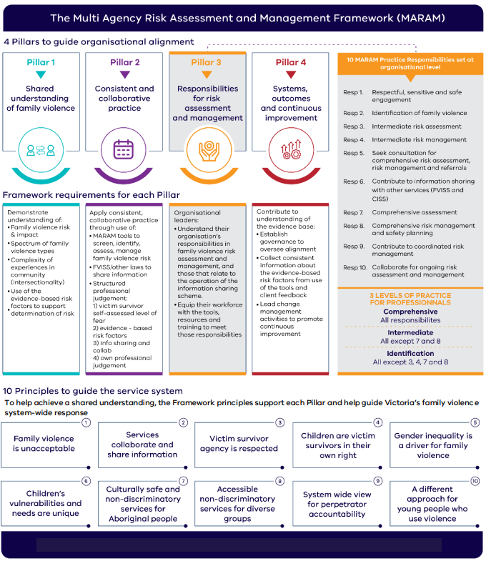
MARAM on One Page
Source: MARAM Framework on a page 2022 (5).pdf
Notes:
Pillar 3 and Responsibility 6 directly relates to FVISS and CISS.
Pillar 3 builds on Pillars 1 and 2 and describes responsibilities for facilitating family violence risk assessment and management. It provides advice on how professionals and organisations define their responsibilities to support consistency of practice across the service system, and to clarify the expectations of different organisations, professionals and service users.
Responsibility 6:
Professionals required to have knowledge of Responsibility 6 should be able to:
proactively share information and make requests seeking relevant to the assessment and management of family violence risk, including under the FVIS Scheme, privacy law or other authorisation at law
proactively share information relevant to broader safety and wellbeing issues for children using the CIS Scheme
respond to requests to share information from other services.

Slide 16
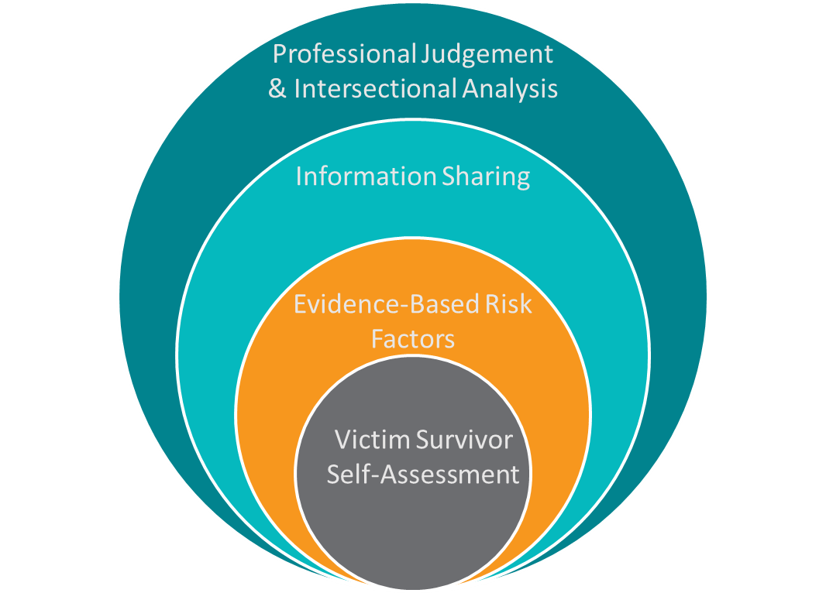
MARAM Structured Professional Judgement Model
MARAM practice guides: Foundation knowledge guide

Slide 17
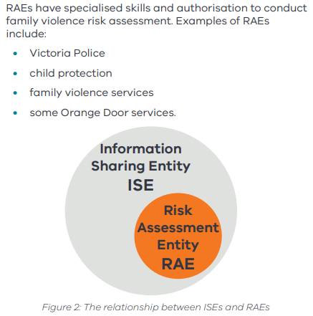
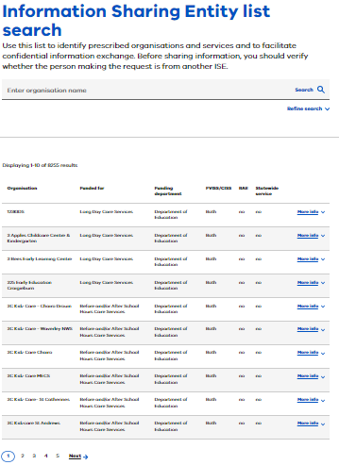
Information Sharing Entity (ISE) & Risk Assessment Entity (RAE)
https://www.vic.gov.au/ise-list-search
Notes:
Risk Assessment Entities (RAEs) are a sub-set of ISEs that are authorised to conduct a comprehensive risk assessment and can request and disclose information for a family violence assessment purpose under the FVISS to establish the presence and source of family violence risk. RAEs are therefore able to request information from other ISEs about alleged perpetrators, in addition to information about perpetrators, victim survivors and third parties for a family violence assessment purpose.
An Information Sharing Entity (ISE) is an organisation or service that has been prescribed in regulations to request and share information under the Child Information Sharing Scheme (CISS) and the Family Violence Information Sharing Scheme (FVISS).
ISE’s cannot request information for the purpose of assessing risk, rather for risk management purposes to facilitate the completion of MARAM’s.

Slide 18
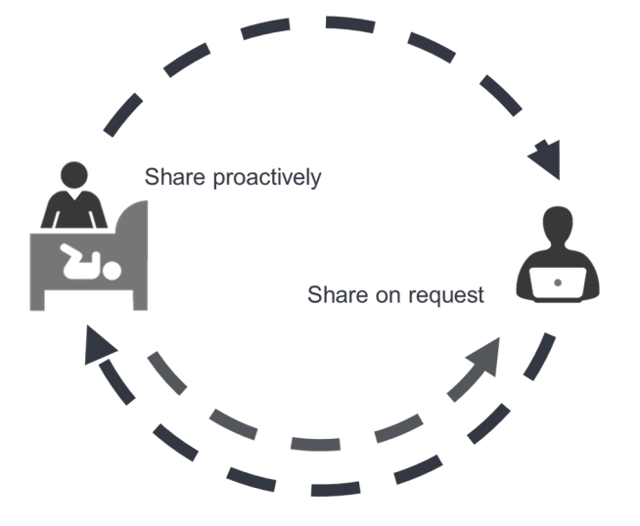
Information Can Be Shared
Notes:
Reminder for the participants: The ISS cannot be applied to staff disclosures of Family Violence.
Refer to: Australian Health Practitioner Regulation Agency - Joint Position on Family Violence by Regulators of Health Practitioners (ahpra.gov.au)
If unsure about your responsibilities, follow up with your HR department

Slide 19
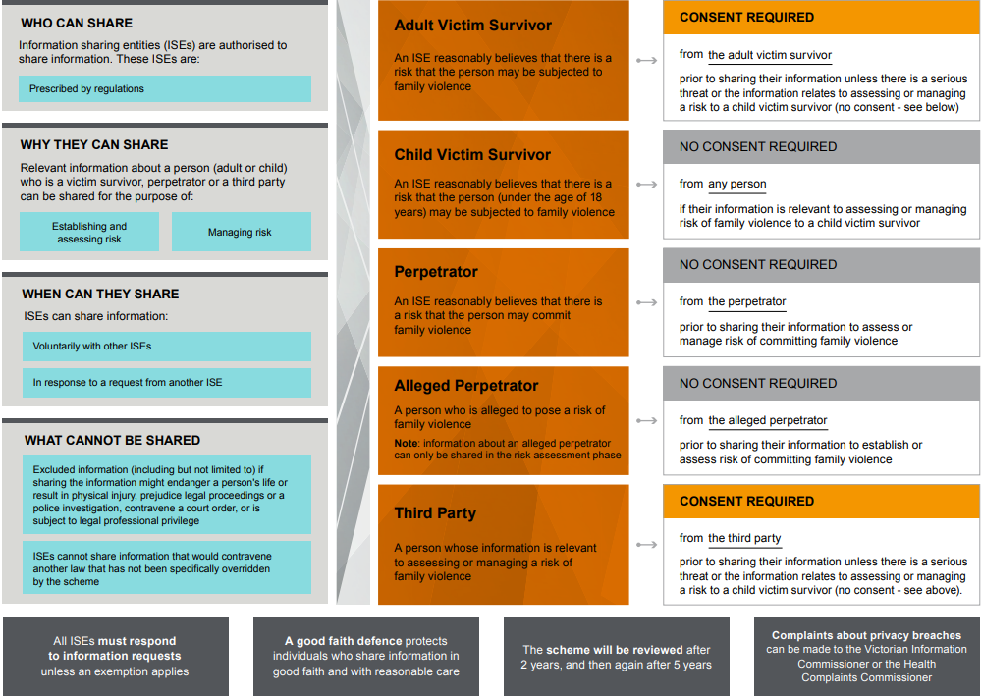
FVISS
‘Figure 1 – Overview of FVISS’ Ministerial Guidelines FVISS, P. 23
Notes:
Family Violence Information Sharing Scheme (Part 5A Family Violence Protection Act 2008)

Slide 20
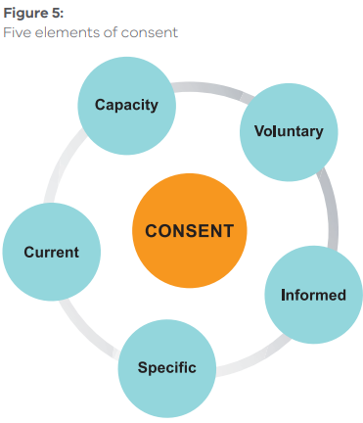
Elements of Consent
Notes:
What is consent?
Part 5A defines consent to mean express and implied consent. Express consent is when a person has expressly, either verbally or in written form, given their consent to their information being shared. Implied consent is not expressly given, but can be inferred through a victim survivor or third party’s conduct or behaviour and the facts of a given situation.
Consent:
Capacity Generally, when a person has capacity to make a particular decision.
Voluntary A person must be free to exercise genuine choice. Consent must be given without coercion or threat and with sufficient time to understand the request and, if appropriate, obtain advice.
Informed The person must have full knowledge of all relevant facts, including: ρ what information will be collected, used or disclosed ρ what purpose the information will be put to ρ with whom the information might be shared and how it might be used ρ the consequences of giving consent, and of failing to give consent ρ the circumstances in which their information may be shared without their consent.
Specific Consent must be specific. If the information given is too broad or vague, the consent may not be specific enough to be regarded as valid. ISEs should consider: ρ the nature of the information ρ the proposed use or disclosure ρ the recipient and its proposed use.
Current Consent is not indefinite. ISEs should inform the person of the period the consent will cover in the absence of a material change of circumstances that the organisation knows or ought reasonably to know. ISEs should make it clear to the person that they are entitled to change their mind and revoke consent at any time.

Slide 21
Exceptions to requiring consent
Consider the Health Records Act (2001) before sharing health related information
Child Information Sharing Scheme
Adult/Person Using Family Violence
Serious Risk to Victim Survivor
Notes:
Health Record Act (2001): Health Records Act 2001 | legislation.vic.gov.au
CISS:
Consent only applies to FVISS not CISS.
Under CISS, information sharing entities do not require consent from any person to share relevant information. However, it is important to note that a professional should seek and take into account the views of the child and their relevant family members where it is appropriate, safe and reasonable to do so.
AUFV/PUV:
Consent is not required for ISEs to share information about a person who is alleged to pose a risk of family violence (alleged perpetrator) or a perpetrator of family violence. Before sharing the information, ISEs must establish that the information is relevant to assessing and/or managing family violence risk and that it is not excluded.
Serious Risk to Victim Survivor
Relevant information can be shared with other ISEs without requiring the victim survivors consent if the threshold of ‘serious threat’ to an individual’s life, health, safety or welfare has been met.
Victorian privacy legislation
Under Victoria's Health Records Act (2001), information can be shared without consent if you believe the information is required to lessen or prevent a serious threat to an individual's life, health, safety or welfare.
'Serious threat' in these Acts includes family violence, and/or a serious risk to child safety and wellbeing
You do not need to wait for a serious risk of harm to share information under the information sharing schemes. The purpose of the schemes is to help workforces/organisations collaborate and share information earlier to prevent situations escalating to a 'serious threat'

Slide 22
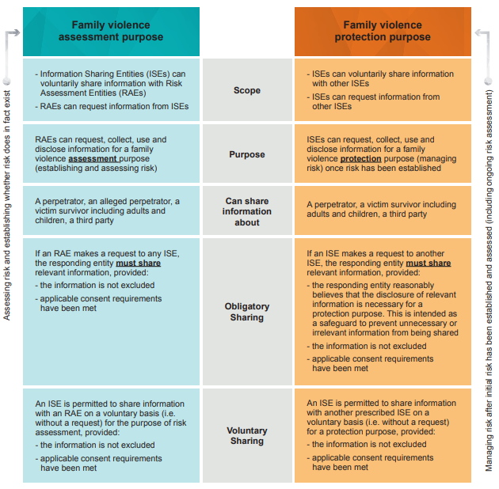
Comparison: Family Violence Assessment and Protection Purpose
‘Figure 2 – Comparison between the family violence assessment and protection purposes’ Ministerial Guidelines FVISS, P. 41

Slide 23
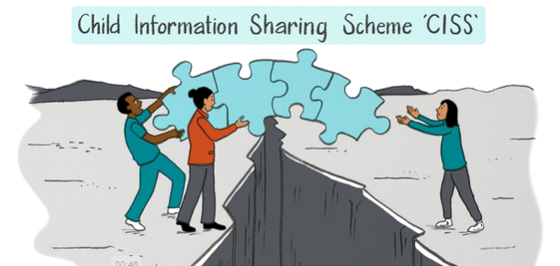
CISS
https://www.vic.gov.au/child-information-sharing-professionals
Notes:
Play the video up to 1:00: https://www.vic.gov.au/child-information-sharing-professionals
*Note: Will need to scroll down page until heading ‘How Child Information Sharing works’*

Slide 24
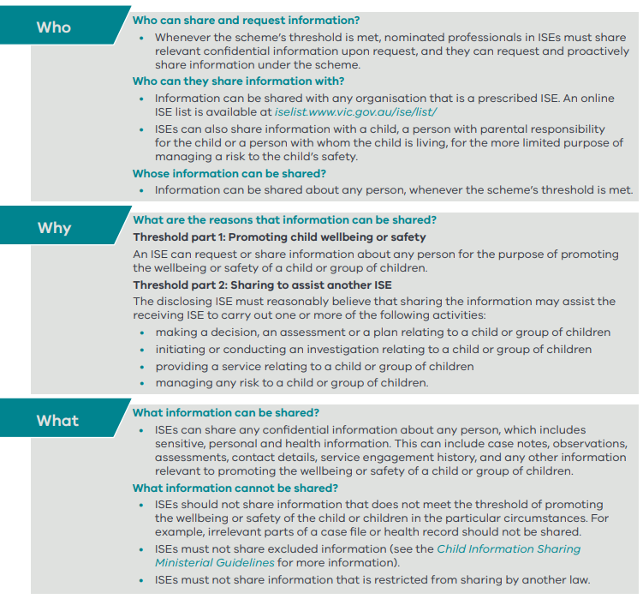
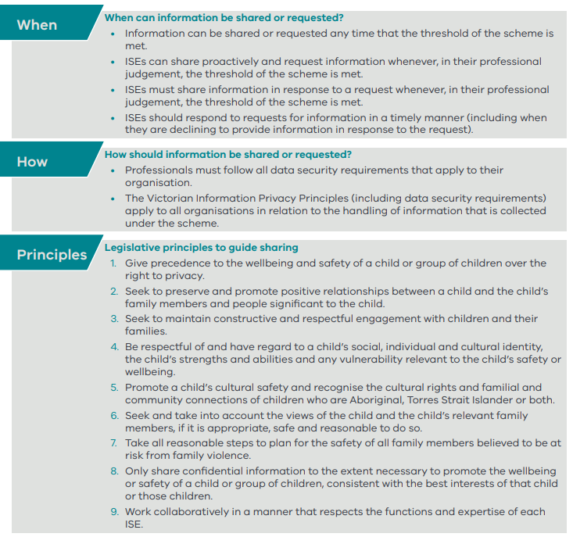
CISS Summary
Child Information Sharing Scheme summary (2018)

Slide 25
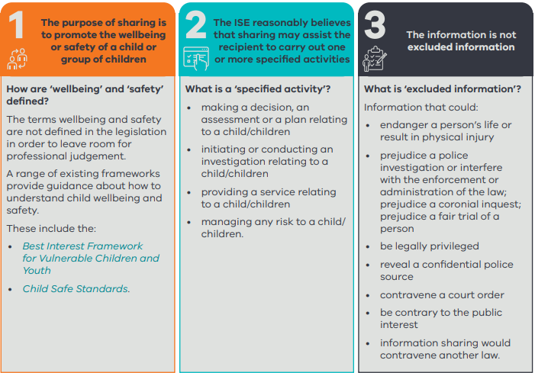
Requirements: CISS
Diagram showing the three-part threshold test for CISS’ (Information Sharing and Family Violence Reforms Toolkit: For centre-based education and care services; government, Catholic and independent schools; system and statutory bodies; and education health, wellbeing and inclusion workforces p.12).

Slide 26
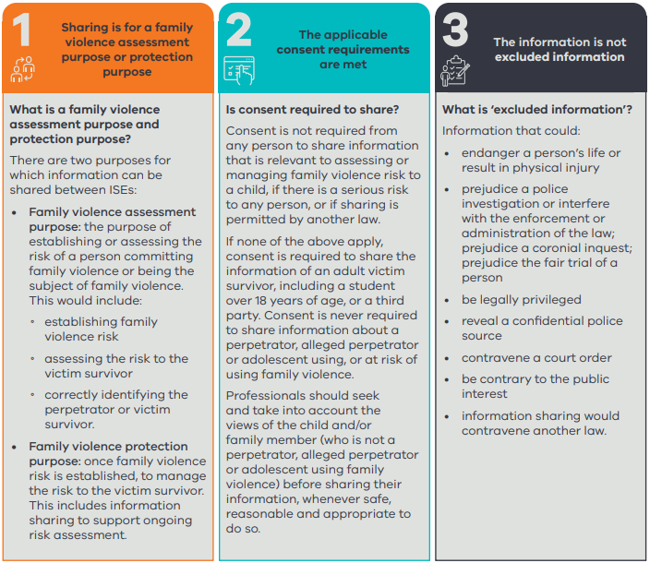
Requirements: FVISS
Diagram showing the three requirements for FVISS’ (Information Sharing and Family Violence Reforms Toolkit: For centre-based education and care services; government, Catholic and independent schools; system and statutory bodies; and education health, wellbeing and inclusion workforces p.13).

Slide 27
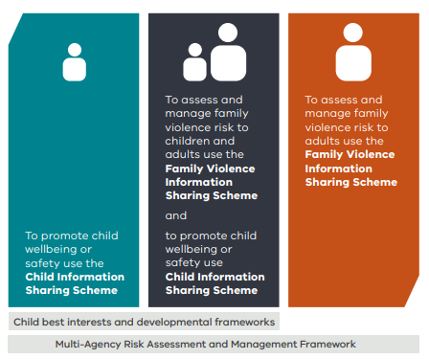
Intersection of the Schemes
Notes:
There are three possible scenarios to determine which scheme applies:
Where you wish to share information to promote a child/children’s wellbeing or safety and family violence is not believed to be present, use the Child Information Sharing Scheme (CISS).
Where family violence is believed to be present and a child is at risk, use the Family Violence Information Sharing Scheme (FVISS) to assess and manage family violence risk to both children and adults (such as parents), as well as the CISS to share information to promote the child’s wellbeing and/or other aspects of their safety.
Where no children are at risk, use the FVISS to share information to assess or manage family violence risk to adults.
How do the schemes work together?
In a family violence context, there are likely to be a range of co-existing wellbeing and/or safety issues arising for a child — for example, delayed development. Hence, the CISS must also be applied to promote the wellbeing and safety of a child more broadly.
Both information sharing schemes recognise that a child’s safety takes precedence over any individual’s privacy. Under the FVISS, both adult and child victim survivors’ safety takes precedence over a perpetrator’s privacy. As a result, consent is not required under either scheme to share information to keep a child safe.
Both schemes recognise the importance of seeking the views and promoting the agency of children and adults (who are not perpetrators of family violence) wherever appropriate, safe and reasonable to do so.
The Family Violence Multi-Agency Risk Assessment and Management Framework (MARAM) must always be applied to identify and guide the assessment and management of family violence risk — for children and adults. This is to ensure that information is shared safely and lawfully, so as not to escalate family violence risk.
The Best Interests Framework for Vulnerable Children and Young People and other developmental practice frameworks are always applicable in assessing and responding to the wellbeing or safety of children, including where family violence is present.

Slide 28
Excluded Information
Endanger a person’s life or result in physical injury
Prejudice legal proceedings, a police investigation or coronial inquiry
Contravene a court order, or if the information is subject to legal professional privilege
Be contrary to public interest
Notes:
Excluded information includes information which, if shared, might:
• endanger a person’s life or result in physical injury – e.g. If sharing the address of the victim survivor could alert a person known to pose a threat to the victim
• prejudice legal proceedings, a police investigation or coronial inquiry – e.g. information reveals the details of a police investigation
• contravene a court order, or if the information is subject to legal professional privilege – e.g. the information is subject to a suppression order of the court
• be contrary to public interest – e.g. information could reveal covert investigation techniques, this information should not be shared
RES_8.1-Excluded-information-fact-sheet_08102019.pdf (vaada.org.au)

Slide 29
Safeguards and Protections
Only authorised organisations and services can share and are bound by Ministerial Guidelines.
Offences may apply where information is shared in ways that are not permitted.
Good faith defence provides protection for individual workers.
Notes:
If an individual acts in good faith and with reasonable care when sharing information under the Scheme, they will not:
… be held liable for any criminal, civil or disciplinary action for providing the information
… have breached any code of professional ethics or to have departed from any accepted standards of professional conduct.
Complaints may be made directly to an ISE or through existing complaints mechanisms under privacy laws.

Slide 30
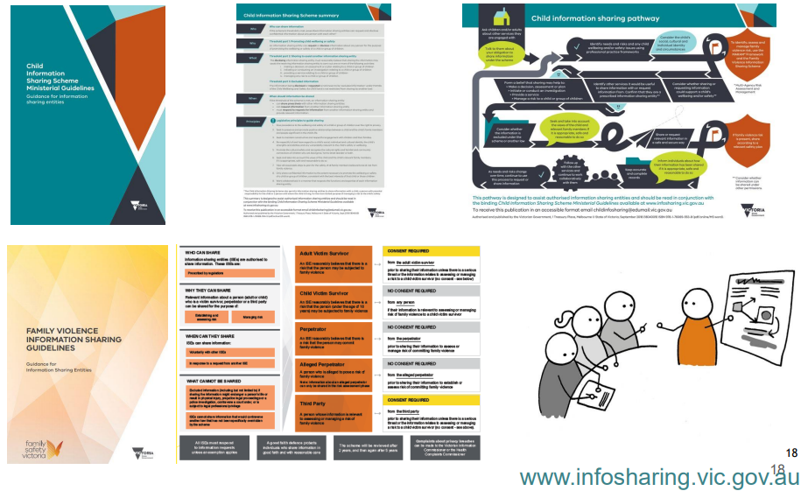
Ministerial Guidelines

Slide 31
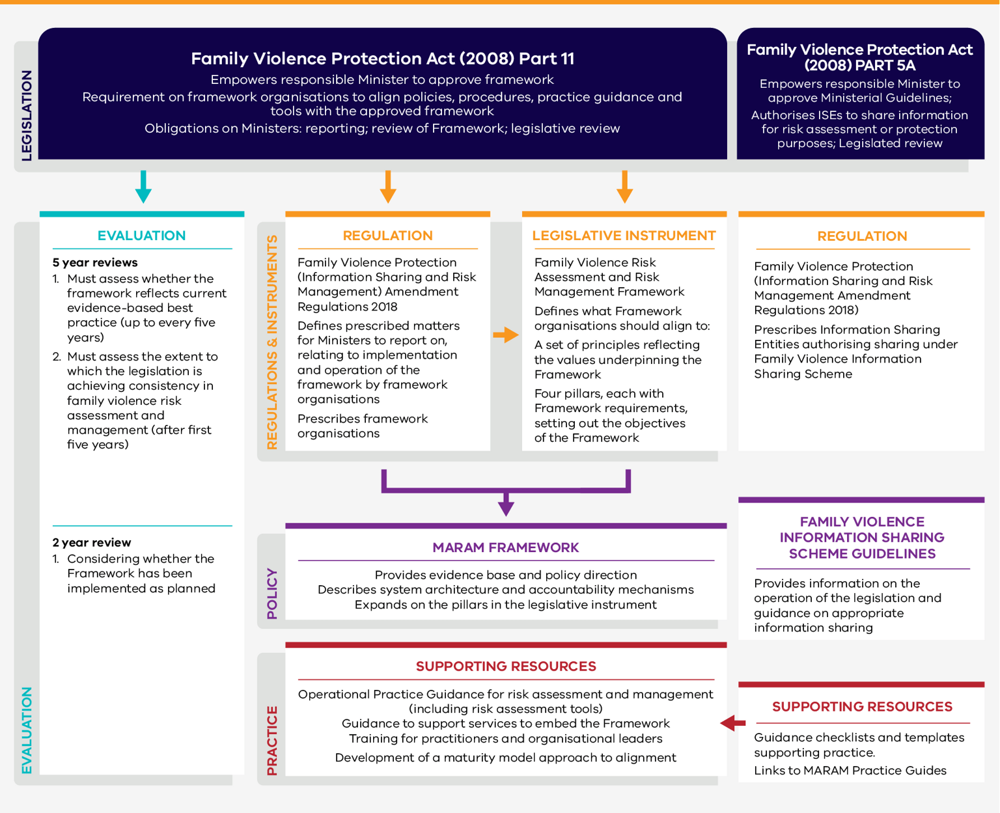
Overview of Legislation, Policy and Frameworks
Figure 2: Overview of legislation, policy and frameworks that support Victoria’s response to family violence’, Report on the implementation of the Family Violence Risk Assessment and Management Framework 2021-22
Notes:
Overview of legislation, policy and frameworks that support Victoria’s response to family violence

Slide 32
Review of Implementation

Slide 33

Implementation Progress
MARAM
FVISS
CISS
Communications
Policies
Partnership
Change management
Procedures
And …
Staff capacity building
Notes:
Large group Activity:
‘What has your hospital/service already reviewed or amended based on the reforms?’

Slide 34
A Proposed Checklist for Evaluation of the Schemes
1. Determine governance structure
2. Develop a project brief
3. Engage leadership and communication
4. Consider establishing an Information Sharing Scheme Working Group
5. Define the internal system
6. Policy development
7. Staff training and capability development
8. Maintaining records
9. Managing access to information and Freedom of Information requests
10. Consideration outside of standard business hours
11. Communication
12. Data collection

Slide 35
Information Sharing Schemes (ISS) – Implementation Plan
Policies and Procedures
Network-wide policy to inform and guide practice
Staff Capability Building
All impacted workforces are to be trained to the level relevant to their role.
Roles and Responsibilities
Change Management / Communications
Policy
Procedure
ISS Request form
After-hour implementation plan
Sample precedent letter templates, outlining reason for sharing/ not sharing
Systems and Technology
Clear allocation of delegated staff with internal decision-making authority to share relevant information under the Schemes
List of delegates from key departments
Mapping doc/plan
Updated PDs
Centralised secure electronic system to ensure privacy and security compliance
Information Sharing Email address
IT Data / Physical records security plan
All staff working within prescribed ISE program areas are to be knowledgeable and confident regarding the legislation and changes to practice.
Induction and training Plan for All Staff
Tailored training as required
Communication plan
Governance structure
Notes:
Policies and procedures:
Ensure the Intranet has external 24 hour contact options
i.e. Safe Steps, 000
For urgent risk call police 000

Slide 36
Practice Examples
ISS Request Form
ISS Policy and Procedure
Example PDs
Training Resources
Decision making trees

Slide 37
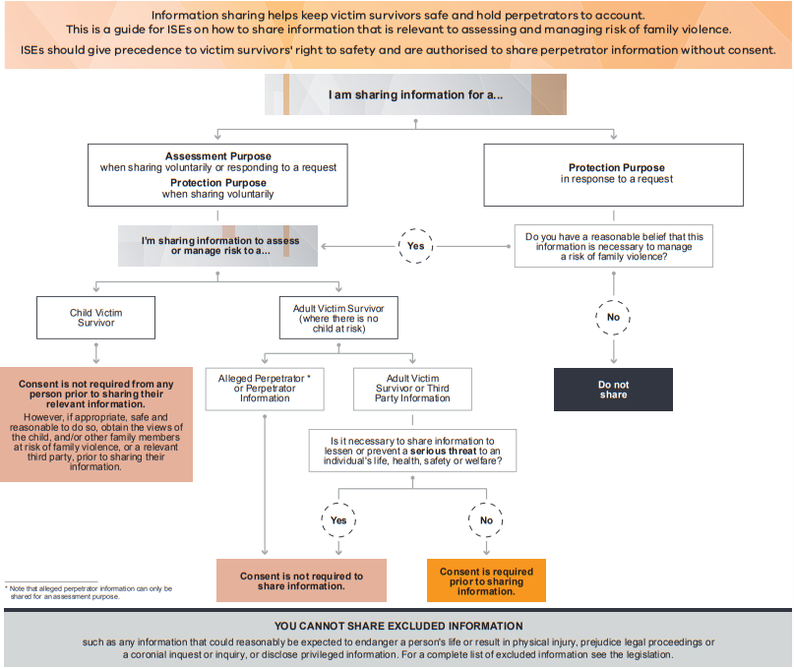
Family Violence
Information Sharing Scheme
Notes:
Note: this is for FVISS not CISS

Slide 38
Information Sharing Scheme:
Example Delegated Working Group
ISS Lead
Legal
SHRFV / Specialist Family Violence Advisor / Staff with FV portfolio
Social Work
Health Information Management
Freedom of Information Team
Information Technology Department

Slide 39
Keeping Records
About the request
About the info shared
Consent / wishes and views
Any family violence risk assessment
Who requested, what information and the date the request.
What information was shared, who was shared with and the date it was shared.
A relevant family violence risk assessment and safety plan in respect of a victim survivor about whom the information relates and any other family members who are at risk of being subjected to family violence.

Slide 40
Intersectionality: Ethical Practice to Mitigate Potential Unintended Consequences
Aboriginal and Torres Strait Islander people have historical and ongoing grounds for fear and suspicion of authority, which has implications for consent and privacy.
The many factors may impact a person’s individual experience of family violence and affect their response to information sharing
Experiences of discrimination, oppression and trauma may make some victim survivors fearful of or unwilling to give consent to share their information
Some communities’ understanding of privacy may be influenced by cultural traditions and beliefs.
Notes:
Further resources: https://www.vic.gov.au/everybody-matters-inclusion-and-equity-statement

Slide 41
The Ideal Change
Improved Outcomes
Positive culture
Shared values and beliefs
Secondary consultation and seeking advice
Collaborative practice
Opportunities for improvement
Sharing early
Proactive sharing
Penetrative rather than reactive
Ethically engagement in practice
Consistent Approach
Collaboration with other services
Integrated service delivery
Continuous improvements

Slide 42
Practice Examples

Slide 43
Example Case Studies for Staff Training
Case Study | Keywords
One | Antenatal, Emergency Department (ED)
Two | Elder abuse, Community Rehabilitation Program (CRP)
Three | Children, Emergency Department of a Paediatric Hospital
Notes:
Example case studies for staff training – found in ‘FVISS and CISS: Implementation guide for hospitals and integrated health services’.
Refer to guide pages below for case study that works best for your health service.
Case Study 1: page 51
Case Study 2: page 54
Case study 3: page 57

Slide 44

Collaborative Practice
Photo by Hannah Busing on Unsplash
Notes:
Collaborative practice entails agencies and service providers working together to enhance the quality of support for individuals and families seeking assistance.
For those experiencing domestic, family, or sexual violence, multiple services and organisations may be involved in providing support. By collaborating—based on the individual’s needs and consent—organisations can streamline their response and prevent duplication of information gathering. This coordinated approach ensures individuals receive consistent advice across services and reduces the risk of re-traumatisation by minimising the need for them to repeatedly share their experiences.
Reference: Collaborative practice | 1800RESPECT
NB: Each Family Violence Regional Integration Committee offers free MARAM Collaborative Practice to help practitioners improve their ability to work collaboratively across the sector.
Find your relevant RIC here: Regional integration committees | Safe and Equal

Slide 45

Wellbeing and Sustainability
Photo by Bekir Dönmez on Unsplash
Notes:
1800RESPECT is also for staff working with family violence victim survivors/adults using family violence and want to debrief.
Wellbeing of Participants:
Emphasise self-care and emotional support during training.
Acknowledge the challenges of discussing family violence and offer support resources.
Encourage boundaries and regular check-ins with personal emotions.
Reflection time is important to process the material.
Trainer’s Role in Supporting Wellbeing:
Create a safe environment for participants.
Be aware of emotional impacts and provide ongoing support.
Reinforce self-care practices and sustainable approaches in their work.
Wellbeing in Future Training Sessions:
Trainers should highlight wellbeing to participants when they run their own sessions.
Encourage safe spaces for discussion and tools for emotional resilience.
Emphasise sustainability in both personal wellbeing and in their work with others.
How to reduce burn out and vicarious trauma

Slide 46
Resources
Information sharing and MARAM reforms https://www.vic.gov.au/information-sharing-schemes-and-the-maram-framework
Information sharing guides, templates and tools https://www.vic.gov.au/guides-templates-tools-for-information-sharing
Child Information Sharing Scheme Ministerial Guidelines https://www.vic.gov.au/child-information-sharing-scheme-ministerial-guidelines
Family Violence Information Sharing Guidelines: Guidance for Information Sharing Entities Ministerial Guidelines - Family Violence Information Sharing Scheme_2.pdf (content.vic.gov.au)

Slide 47

Thanks!
For more information, please contact:
SHRFV@thwomens.org.au

