Slide 1



Strengthening Hospital Responses to Family Violence
Family Violence Multi-Agency Risk Assessment and Management (MARAM)
Intermediate Victim Survivor Training Module 1
Released August 2021

Slide 2
A safe learning environment
Uphold the dignity and privacy of the people we work with
Commitment to participation, but with the right to pass
Attitude of curiosity
Practice self-care
Permission for facilitators to move the group along
Phones on silent and out of sight, unless essential
We can’t be articulate all the time!
Respectful conversations

Slide 3



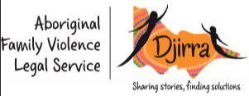





Self-care

Slide 4

Introductions

Slide 5




Learning objectives
Capability to engage effectively with those accessing your service and respond as a MARAM Intermediate-aligned practitioner.
Capability to identify and assess family violence risk at an intermediate level utilising the MARAM tools.
Capability to manage risk and prioritise the safety of child and adult victim survivors of family violence as a MARAM Intermediate-aligned practitioner.
.
Ability to provide effective services informed by the MARAM Framework.

Slide 6
Training overview
Module 2
Observable signs of trauma
Effective engagement
Child-focused practice
Module 3
Evidence-based risk factors
Risk assessment tools
Structured Professional Judgement model
Seriousness of risk
Misidentification
Module 4
Intermediate risk management
Module 1
Reform context
MARAM
Foundational knowledge
Attitudes, structural inequality & discrimination
Barriers to disclosure
Safety planning
Keeping perpetrators in view and accountable
Workplace supports

Slide 7

Overview of the Victorian Family Violence
reform context

Slide 8
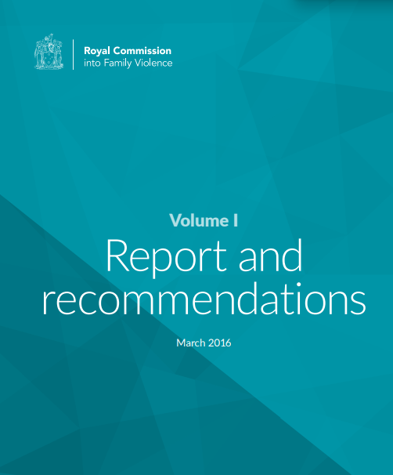

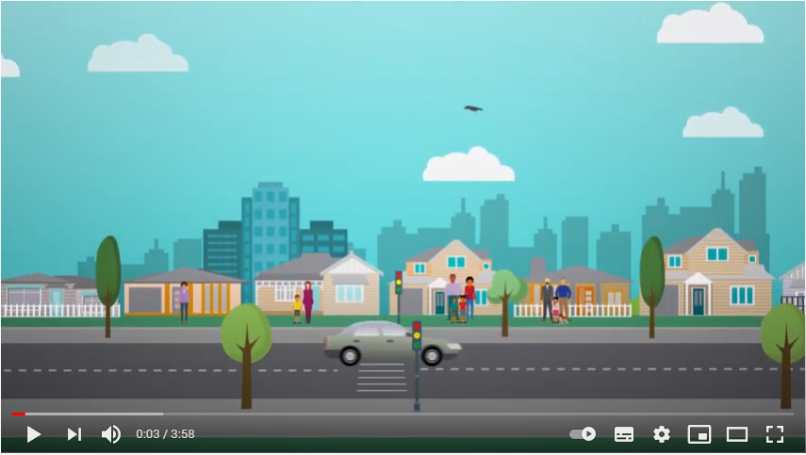
Overview of the Family Violence reform context

Slide 9
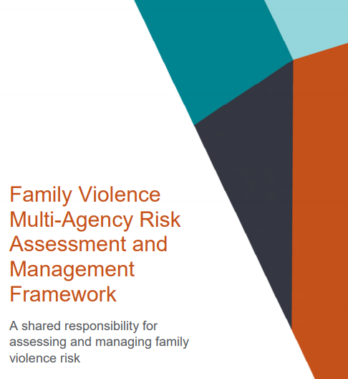
MARAM
The aim of MARAM is to increase the safety and wellbeing of Victorians by ensuring:
Shared understanding of family violence
Are effectively identifying, assessing and managing family violence risk, consistent with their roles within the service system
Establish a system-wide approach
Have a collective responsibility to keep victim survivors safe, and to keep perpetrators in view and hold them accountable for their behaviours and actions

Slide 10
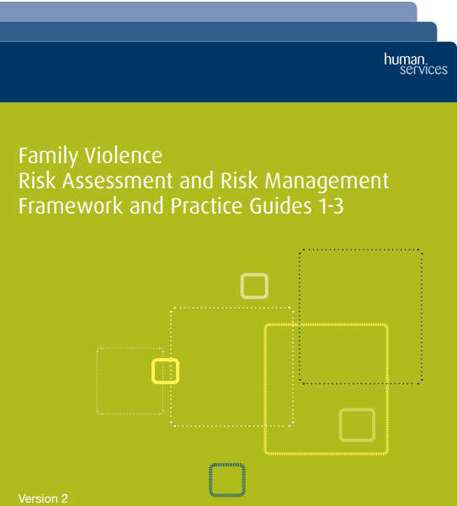
Changing Framework
Key changes from CRAF:
  MARAM is legislated
Comprehensive suite of resources
Wider range of risk factors
Intersectional lens
Children are situated as victim survivors in their own right
Collective responsibility to keep perpetrators in view accountable for their behaviours
Collaborative practice in the integrated service system

Slide 11
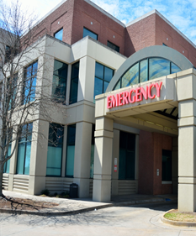


Integrated service system
All prescribed services within the service system have an important role to play in supporting effective responses to family violence.

Slide 12

Pause and reflect
How does family violence present in your service?

Slide 13
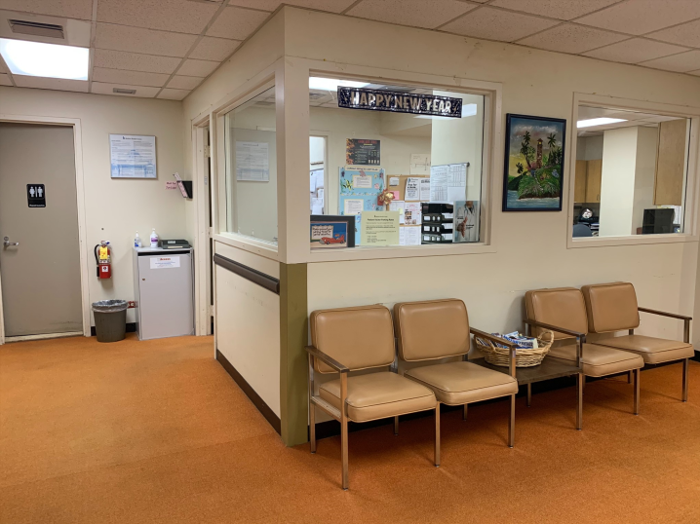




Royal Commission: Health Services
‘Not all victims of family violence are able to, or choose to seek assistance from a specialist family violence service.
Many will disclose violence or sexual assault to a trusted health professional in the context of seeking care for themselves or their children’
‘women who experience family violence use health services more often than others.’
It is ‘critical that health workers are able to respond and help victims to obtain the services
they
need’
Some victim survivors ‘interact with health professionals at times of heightened risk of family violence or seek treatment for injuries or medical conditions arising from
violence they have experienced’

Slide 14

Empathetic and professional response
An empathetic and professional response from a trusted social worker, nurse or other health professional can reinforce a patient’s understanding that they are entitled to healthy relationships and a life free from violence.
By respecting the decisions of patients and offering a range of options, health professionals have a vital role in ensuring that health needs are met, inclusive of a patient’s safety..

Slide 15
What is my role under MARAM?
1: Respectful, sensitive & safe engagement
2: Identification of family violence risk
3: Intermediate risk assessment
4: Intermediate risk management
5: Seek secondary consultation and referral, including for comprehensive family violence assessment and management response
5. Contribute to information sharing with other services (as permitted by legislation)
7: Conduct comprehensive risk assessment
8: Conduct comprehensive risk management
9: Contribute to coordinated risk management
10: Collaborate for ongoing risk assessment and risk management
MARAM outlines 10 Responsibilities that comprise an effective response.

Slide 16
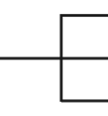
What is my role under MARAM?
Different professionals have different levels of responsibility as part of an integrated systems response.
Foundational Practice
Identification and Screening
Sensitive Practice
Screening
Intermediate
These distinctions are specific to the operating environment within SHRFV hospitals and health services.
Comprehensive

Slide 17
What is my role under MARAM?
1: Respectful, sensitive & safe engagement
2: Identification of family violence risk
3: Intermediate risk assessment
4: Intermediate risk management
5: Seek secondary consultation and referral, including for comprehensive family violence assessment and management response
5. Contribute to information sharing with other services (as permitted by legislation)
7: Conduct comprehensive risk assessment
8: Conduct comprehensive risk management
9: Contribute to coordinated risk management
10: Collaborate for ongoing risk assessment and risk management
MARAM outlines 10 Responsibilities that comprise an effective response.

Slide 18
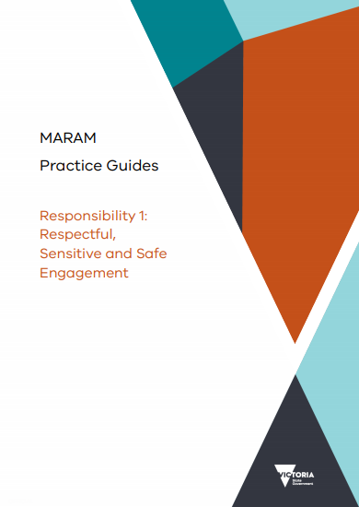
MARAM Practice Guides
MARAM Practice Guides
Foundational Knowledge Guide
Adult and child victim-focused MARAM practice guides for Responsibility 1-10
Adult perpetrator-focused MARAM practice guides for Responsibility 1-10
These should be referred to along with your organisation’s policy and procedures after this training to guide your work.

Slide 19
Foundational knowledge: a shared understanding
of family violence

Slide 20





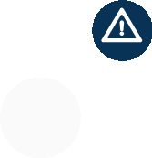

Definition of family violence
Emotionally or psychologically abusive
Physically or sexually abusive
Economically abusive
Behaviours that cause a child to witness, hear or otherwise be exposed to the effects of family violence.
The Family Violence Protection Act 2008 (Vic) defines ‘family violence’ as:
A behaviour by a person towards a family member that is
Causes fear for own safety and/or the safety of others
Threatening or coercive
Controlling and dominating

Slide 21

Definition of family violence
The Victorian Indigenous Family Violence Task Force (2003) defines family violence in the context of Aboriginal communities as:
An issue focused around a wide range of physical, emotional, sexual, social, spiritual, cultural, psychological and economic abuses that occur within families, intimate relationships, extended families, kinship networks and communities.

Slide 22


Check your understanding
The presence of fear
Arguments happening every week
A volatile relationship
All of the above
What distinguishes ‘relationship conflict’ from family violence?

Slide 23
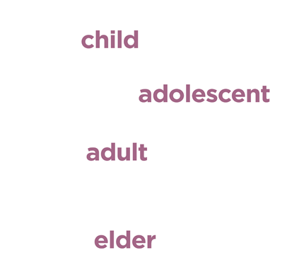
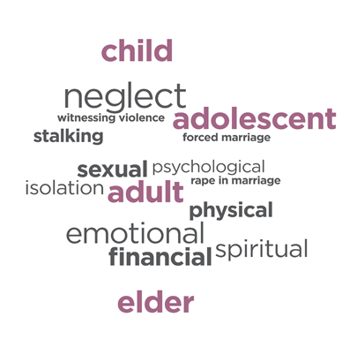
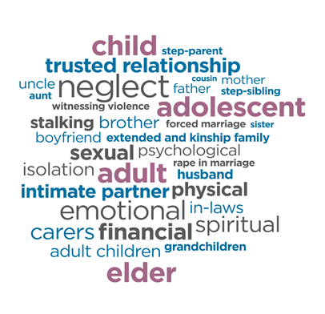







Definition of family violence

Slide 24
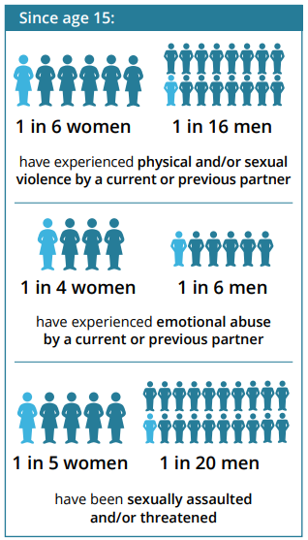
Prevalence and gendered nature
Around 95% of victims of all types of violence experience violence from a male perpetrator.
(Diemer, 2015)
Australian Bureau of Statistics, 2017)

Slide 25
Prevalence and gendered nature
Women’s experience of family violence
Women are more likely to experience family violence from someone they know, in their own home and in an on-going way.
(Cox, 2015)
Men’s violence against female partner is more likely to inflict severe injury and result in the female living in fear.
(Bagshaw & Chung, 2000)
Women’s violence against male partners is more likely to be in self-defence when the male partner is violent.
(Bagshaw & Chung, 2000)
Men’s experience of family violence k
Men are much more likely to experience violence from a stranger or non-intimate acquaintance or family member, in public, and as a once off incident.
(Cox, 2015)
75% of adult male family violence victims reported not feeling fearful of the perpetrator.
(Victorian Family Violence Database, 1999-2010)

Slide 26
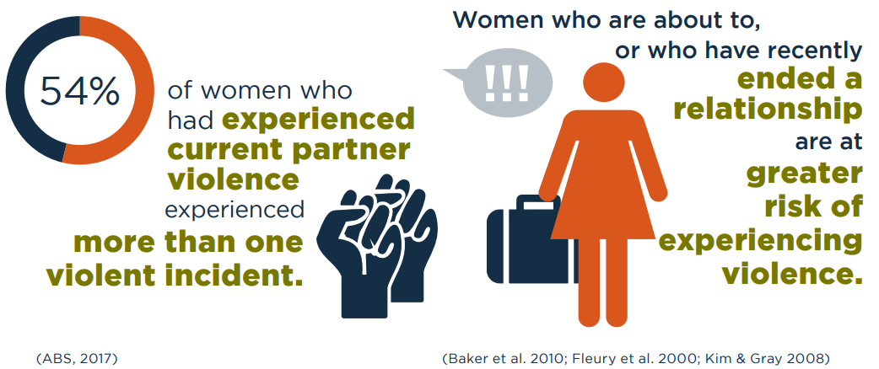
Prevalence and gendered nature

Slide 27
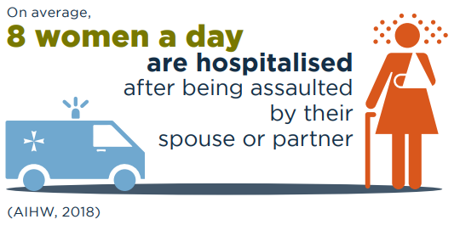
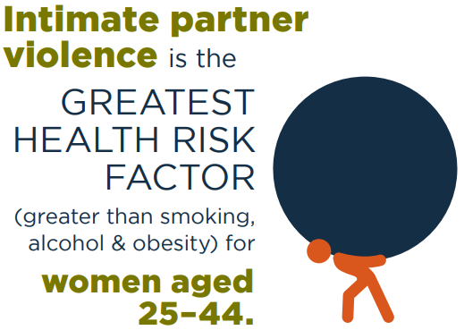
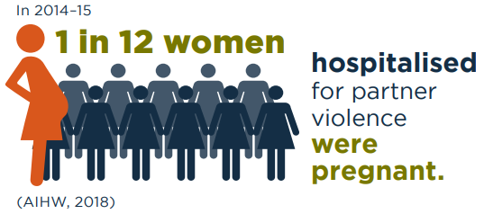

Family violence is a health issue
Ayre et al, 2016)
40% of people who presented
to a Victorian hospital
emergency department with
a family violence related injury
had sustained a brain injury.
(Brain Injury Australia, 2018)

Slide 28
Check your understanding
When in public and a stranger is violent
When pregnant
When she is about to or has recently
ended a relationship
When with someone they don’t know
When is a woman at greater risk of experiencing family violence?
(choose two options)

Slide 29
Understanding attitudes, structural inequality & discrimination

Slide 30

Attitudes and gender inequality
Our Watch, Let’s change the story: Violence against women and children in Australia

Slide 31
Check your understanding
Poverty
Alcohol
Growing up in a household where
family violence occurred
Gender inequality
Which of the following did Our Watch’s research find to be the key driver of family violence?

Slide 32

Prevalence
  Populations most impacted by family violence:
    Aboriginal and Torres Strait Islander women
    Young women
    Pregnant women
    Older people
    Women with disabilities
    Women experiencing financial hardship
Australian Institute of Health and Welfare 2018

Slide 33


Prevalence
Emerging evidence also shows that the rates of intimate violence within same-sex relationships are as high as the rates experienced by cisgender women in heterosexual relationships, and possibly higher for bisexual, transgender and gender diverse people.
(Our Watch & GLHV@ARCSHS, 2017)
Aboriginal women are 35x
more likely to be hospitalised
by family violence than
other women.
(Aboriginal and Torres Strait Islander Health
Performance Framework Report, 2012)

Slide 34




Prevalence
Women and girls with disabilities
are twice as likely to experience violence as those without.
(Women With Disabilities Victoria, 2014)
Whilst elder abuse is believed
to be greatly under-reported, the
World Health Organisation estimates that
it affects between 1 to 10% of older
people worldwide.
(World Health Organsiation, 2021)

Slide 35
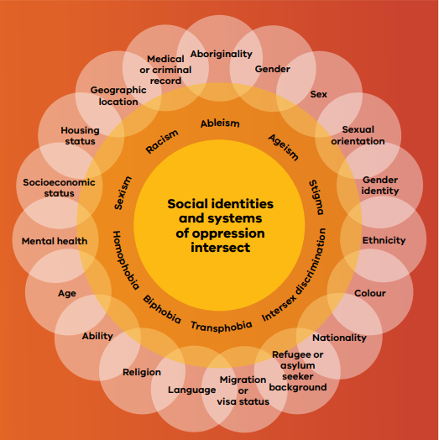
Structural inequality and discrimination
other forms
of structural inequality and discrimination
explain
why there are different rates
and types of violence
Violence is not inherent in any community
in addition to the gender inequality

Slide 36

Intersectionality
Intersectionality is a framework that helps us understand the dynamics of power and interconnected nature of social categories, discrimination and inequalities in our society.
In family violence response an intersectional analysis is used to understand how experiences of discrimination and structural inequalities impacts risk.

Slide 37

Intersectionality
Sexist attitudes that normalise, tolerate and excuse violence against women, when combined with other discriminatory attitudes, such as racism, can lead to some women experiencing particular forms of violence and violence more frequently, or of greater severity.
Example: Women with a disability experience
Sexist attitudes ‘women are weak’
Ableist attitudes ’people with a disability can’t make their own decisions’
And attitudes that are sexist & ableist
            ‘women with a disability are incapable of making their own decisions and will be taken advantage of, so we need to make decisions for them’

Slide 38

Intersectionality
These discriminatory attitudes create organisations, institutions and governments with discriminatory structures, policies and practices that prevent certain groups from having equal access to resources, access to services and service responses that meet their needs.
This leads to some individuals and communities experiencing particular risks and barriers to accessing support to enhance their safety.
Example:
Some women’s accommodation services are not fully physically accessible and some do not have multilingual staff. A woman who is disabled (or has a child who is disabled) or in need of a bi-lingual worker may be presented with barriers to securing accommodation. A women with both accessibility and language needs will find it even more difficult to access such a service.

Slide 39
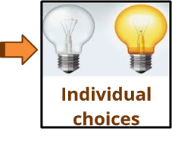
Intersectionality
In individual relationships, these inequalities can play out in a belief that a man is entitled to engage in coercive and controlling behaviours and use violent tactics to exercise power and control over his partner, family member and children.
These inequalities also enable perpetrators to target individuals from diverse communities, through knowing they can use violence with impunity if other discriminatory attitudes are held widely within the community and by service providers.
Example: If a perpetrator knows that the police and health services are less likely to support an Aboriginal woman and her children, then the perpetrator can use violence with impunity, knowing that such violence is tolerated by the community and our social institutions more than violence against non-Aboriginal women.

Slide 40

Intersectionality
Certain groups are therefore not more
‘vulnerable’ but are targeted for violence
more often than other women due to these discriminatory attitudes.
Whilst the use of family violence is a
choice by a perpetrator and the responsibility for the use of violence rests solely with the perpetrator, as a society we all have a role in challenging equality and attitudes and systems that allow this violence to occur.

Slide 41
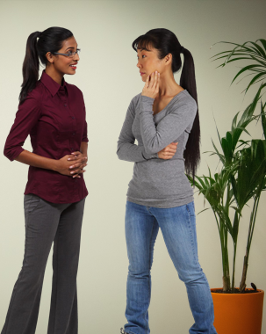
Intersectionality
Responding to family violence must therefore not only address the gendered drivers of family violence but also address other forms of structural inequality and discrimination.
MARAM recognises this and has aimed to embed an intersectional approach to responses to family violence.

Slide 42
Barriers to disclosure

Slide 43
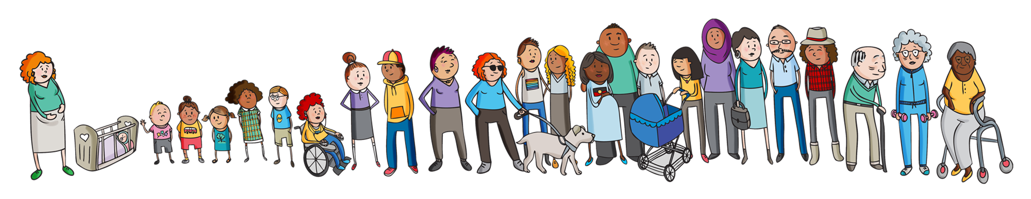
Barriers to disclosure
They have never been asked, or the way they were asked was insensitive, traumatic or victim blaming
Fear of the risk escalating
Concerns about privacy and confidentiality
They have had a bad experience in the past and lack trust in the system
Language or communication barriers
Are not aware of their rights or understand their experiences as family violence
Fear of losing connection with family or community, causing family conflict or ostracision.
Fear of having children removed
Fear about decisions being made for them such as being moved to residential aged care
Feelings of shame and judgement

Slide 44
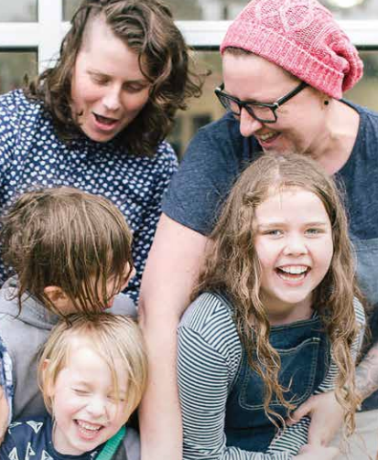

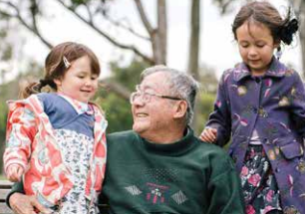


Accessible and inclusive services

Slide 45
Module 1 summary
An overview of the Victorian family violence reform context and MARAM
Foundational knowledge
Understanding attitudes, structural inequality & discrimination
Barriers to disclosure

Slide 46

Reflection
After undertaking any form of training, it is always important to reflect on these questions:
  How might I apply new knowledge and skills?
  What does this content reveal about my work responsibilities or role that I didn’t know before?
  What can I do better as a result?
  What other knowledge or experience does this enhance?
  What further training do I think I need?

Slide 47

Self-care
Responding to family violence can have an impact and at times be overwhelming
Self-care should be a part of your work
Self-care is a shared responsibility between individuals, teams, organisations and systems
Self-care is about knowing and accessing the professional supports available and prioritising what works for you

Slide 48
Thank you

