Slide 1



Strengthening Hospital Responses to Family Violence
Family Violence Multi-Agency Risk Assessment and Management (MARAM)
Intermediate Victim Survivor Training Module 2
Released August 2021

Slide 2
A safe learning environment
Uphold the dignity and privacy of the people we work with
Commitment to participation, but with the right to pass
Attitude of curiosity
Practice self-care
Permission for facilitators to move the group along
Phones on silent and out of sight, unless essential
We can’t be articulate all the time!
Respectful conversations

Slide 3



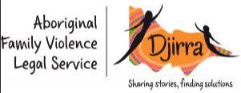





Self-care

Slide 4
Training overview
Module 2
Observable signs of trauma Effective engagement Child-focused practice
Module 3
Evidence-based risk factors Risk assessment tools Structured Professional Judgement model Seriousness of risk Misidentification
Module 4
Intermediate risk management
Module 1
Reform context MARAM Foundational knowledge Attitudes, structural inequality & discrimination Barriers to disclosure
Safety planning Keeping perpetrators in view and accountable Workplace supports

Slide 5

Introductions

Slide 6

Observable Signs of Trauma

Slide 7



What are observable signs of trauma?
These are things we observe, hear or notice, that indicate that someone may be experiencing family violence.
The signs are expressions of trauma that relate to a person’s physical or emotional presentation, behaviour or circumstances, which may indicate family violence is occurring and can be expressed differently across a person’s lifespan and circumstance, from infancy, childhood and adolescence, through to adulthood and old age.

Slide 8

What are observable signs of trauma?
Physical
Bruising, chronic pain, strangulation or complications during pregnancy
Physiological
Emotional
Fear, shame, feeling hopeless or feeling emotionally numb
Social or Financial
Depression, anxiety, impaired concentration or harmful alcohol use
No family or friend support, isolation, homelessness or financial debt
Demeanour
Unconvincing injury explanations, anxiety in the presence of a partner, describing a partner, as controlling or reluctance to follow advice

Slide 9

What are observable signs of trauma?
Observable signs of trauma for a child or your person
Emotional dis-regulation
Developmental regression
Wearing long-sleeved cloths to hide bruising or injury
A strong desire to please or receive validation from certain adults
Internal injuries
Unclear boundaries between adults and children
It is important to note that adults and children experiencing family violence may also not exhibit any of these signs and indicators.

Slide 10
Effective Engagement –
Promoting victim survivor
agency

Slide 11

Promoting agency
A central element of the experience of violence is the loss of control and feeling of powerlessness.
Trauma informed
Engaging in a respectful, sensitive, non-judgemental way
Respect a victim survivor’s right to choose
Victim survivor led
Perpetrator accountability
Person-centred approach

Slide 12
Effective Engagement –
Creating a safe environment

Slide 13




Creating a safe environment
Before you start asking questions, ask yourself whether the conditions are right to proceed.
Does my patient have any immediate health and safety needs?
What will help me communicate with my patient?
Is this a safe space to ask about family violence?

Slide 14
Effective Engagement –
Sensitive response

Slide 15

Sensitive response
How clinicians respond to a disclosure is crucial to eliciting feelings of safety, respect, control and recovery for the victim survivor.
Good responses demonstrate empathy and understanding, and shows that we are capable of hearing disclosures about family violence and providing support.

Slide 16





Sensitive response
Listen to the person closely with empathy and without judging. Reflect back what you have heard.
‘That must have been very frightening for you. Your partner has been controlling and made you feel unsafe.’
Assess and respond to the woman’s emotional, physical, social and practical needs and concerns.
‘What I’m hearing is that at the moment you need support around …’
Show that you understand and believe the victim survivor. Assure them that they are not to blame.
‘It sounds like your partner’s behaviour is having a huge impact on you, there is no excuse to threaten someone or make them feel afraid.’
Discuss a plan to protect themselves from further harm if violence occurs again.
‘You have demonstrated strength and resilience in managing your own safety, how can I best support you with this?’
Support her by helping her connect to information, services and social support.
‘Is it alright if I ask you some more questions so I make sure I connect you with appropriate support?’
(World Health Organisation, 2013)

Slide 17
Effective Engagement –
Responding to discriminatory
attitudes and beliefs

Slide 18

Attitudes and
Beliefs
We all have our own unconscious biases, beliefs and values that we gain from our family, culture and a life time of experiences that will influence how we each view family violence.

Slide 19
Myths and misconceptions
She knows how to push
his buttons
But the kids don’t see him hit me so its not affecting them
Women make up false reports of sexual assault in order to punish men
Older people aren’t able to make their own decisions
Distort
Excuse
Minimise
Perpetuate
Family Violence
It only happens in certain groups or cultures
He gets a bit violent when he drinks but he is a good dad
She can just leave him
It’s normal for a man to control the household
There is no power imbalance in same sex relationships
Men can’t control their urges

Slide 20

Communicating key messages
Challenge victim blaming beliefs
Hold perpetrators accountable
Challenge minimisation of the experience
Challenge any justification for the violence
Recognise experiences as family violence

Slide 21
Effective Engagement –
Culturally safe, accessible and inclusive practice

Slide 22

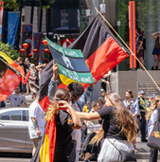
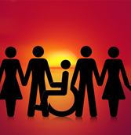




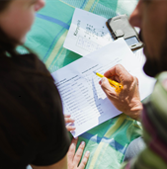
Culturally safe, accessible and inclusive practice
Tailoring engagement to provide a culturally safe, accessible and inclusive service
Ask and acknowledge a victim survivor’s identity and sensitively enquire about individual needs
Carry out practice in collaboration, with regard to their culture whilst being mindful of your own potential biases
Do not challenge or deny a person’s identity and experience
Carry out practice in collaboration, with regard to their culture whilst being mindful of your own potential biases
Recognised and addressed barriers to accessing appropriate support
Seek secondary consultation from culturally specific services
Ensure your practice does not reinforce stigma, stereotypes or discrimination
Provide links to cultural support services (in addition to mainstream services)
Tailor your responses to the individual’s identity and needs

Slide 23

Self-determination for the Aboriginal and Toores Strait Islander community
‘exercising true freedom, full and total control of one’s own safety, healing, connections to land and culture, communities, futures and lives.’
‘having access to community-led information, options and supports.’
‘being supported and empowered to make informed choices about their future’ that promote their safety, wellbeing and healing.’
‘The right to safety in all relationships must be emphasised, through community-led education and the sharing of knowledge about what respect and safety looks like.’
State of Victoria, Department of Health and Human Services, (2018), ‘Dhelk Dja: Safe Our Way - Strong Culture, Strong Peoples, Strong Families’
‘Evidence shows that self-determination works as it recognises that Aboriginal and Torres Strait Islander people hold the knowledge and expertise as to what is best for themselves, their families and their communities.’

Slide 24
Child focused practice

Slide 25
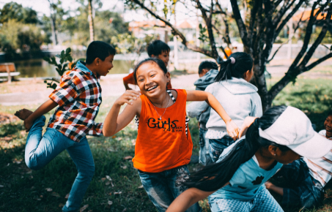
Child focused practice
A key focus of MARAM is recognising children as victim survivors in their own right and considering their own individual experience and needs.

Slide 26
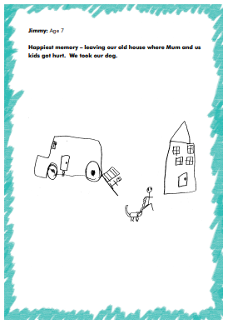
Child focused practice
Jimmy: Age 7
Happiest memory-leaving our old house where Mum and us kids got hurt. We took our dog.
[Children's Resource Program. Through a Child's Eyes.]

Slide 27

Children and young people’s experience of family violence
Children’s voices and experiences of family violence have often gone unheard.
Family violence is traumatic and can impact healthy development.
A perpetrator’s tactics of family violence can directly impact the bond between a child and mother/carer.
Children and young people face additional structural barriers due to their age and dependence on adults that can limit their access to support. This can be compounded by other forms of structural inequalities such as ableism to further limit access to support or increase their likelihood of being targeted by perpetrators.
Children and young people have their own separate and distinct experience, impacts and understanding of the violence to that of their parent/caregiver(s).
Children are impacted by family violence even if they do not directly see or hear it.
1 in 4 children in Australia is exposed to domestic violence. (University of NSW, ADFVC, 2011)
What we also know is that children can be supported to recover from the impacts of family violence.

Slide 28
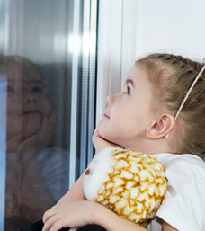
Child focused practice
A child-focused practice under MARAM does not mean that every practitioner will be required to conduct individual appointments with children to complete a risk assessment.
Workers should not be undertaking direct work with children that they do not feel skilled and supported to do.
A child focus is relevant even if you are not working with children directly in your practice.

Slide 29

Child focused practice at an intermediate practice level
Impacts
Indicators
Evidence-based risk factors
Responding to a child’s wellbeing, safety and needs
Strengthening the mother/carer bond
Considering a child’s views and wishes
Working directly with children
Advocacy

Slide 30
Module 2 summary
Observable signs of trauma
Promoting victim survivor agency
Creating a safe environment to disclosures
Sensitive response
Culturally safe, accessible and inclusive practice
Child-focused practice
Responding to discriminatory attitudes and beliefs

Slide 31

Reflection
After undertaking any form of training, it is always important to reflect on these questions:
How might I apply new knowledge and skills?
What does this content reveal about my work responsibilities or role that I didn’t know before?
What can I do better as a result?
What other knowledge or experience does this enhance?
What further training do I think I need?

Slide 32

Self-care
Responding to family violence can have an impact and at times be overwhelming
Self-care should be a part of your work
Self-care is a shared responsibility between individuals, teams, organisations and systems
Self-care is about knowing and accessing the professional supports available and prioritising what works for you

Slide 33
Thank you

