Slide 1



Strengthening Hospital Responses to Family Violence
Family Violence Multi-Agency Risk Assessment and Management (MARAM)
Intermediate Victim Survivor Training Module 3
Released August 2021

Slide 2
A safe learning environment
Uphold the dignity and privacy of the people we work with
Commitment to participation, but with the right to pass
Attitude of curiosity
Practice self-care
Permission for facilitators to move the group along
Phones on silent and out of sight, unless essential
We can’t be articulate all the time!
Respectful conversations

Slide 3









Self-care

Slide 4
Training overview
Module 2
Observable signs of trauma
Effective engagement
Child-focused practice
Module 3
Evidence-based risk factors
Risk assessment tools
Structured Professional Judgement model
Seriousness of risk
Misidentification
Module 4
Intermediate risk management
Module 1
Reform context
MARAM
Foundational knowledge
Attitudes, structural inequality & discrimination
Barriers to disclosure
Safety planning
Keeping perpetrators in view and accountable
Workplace supports

Slide 5

Introductions

Slide 6

Evidence-based risk factors

Slide 7



Evidence-based risk factors
Evidence-based risk factors refers to the current and emerging evidence which research has indicated that when present, a victim survivor of family violence is statistically more likely to be killed or seriously injured.
Serious risk factors are those which may indicate an increased risk of the victim survivor being killed or almost killed.

Slide 8
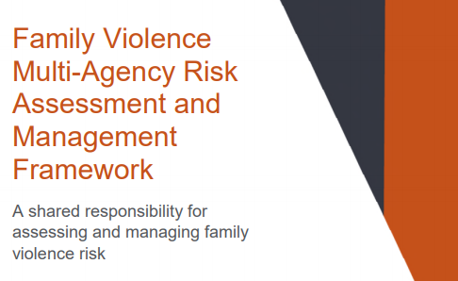
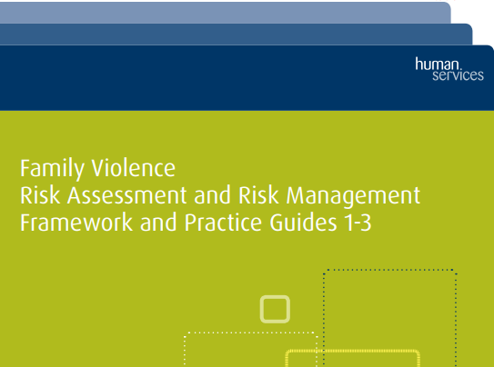
Changes from CRAF
MARAM has built on and reframed some of the evidence-based risk factors under CRAF, including the inclusion of:
Victim/survivor self-assessment
Imminence
Perpetrator history of family violence
Physical harm
Emotional abuse
Evidence-based risk factors specific for
children

Slide 9

MARAM Practice Guides
MARAM Foundational Knowledge Guide provides an explanation for each evidence-based risk factor.

Slide 10
MARAM assessment tools

Slide 11

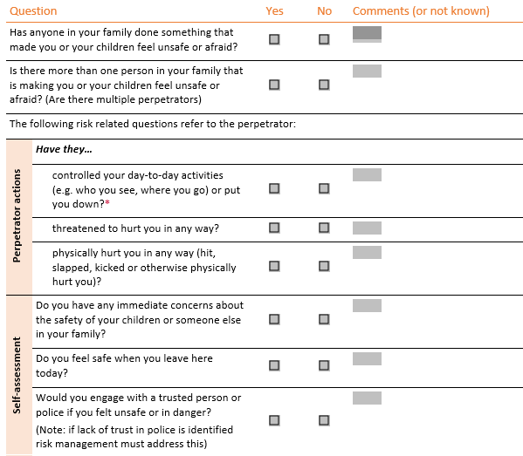
Identification and screening tool
The purpose of this tool is to identify:
If family violence is occurring,
The level of fear
The person who is perpetrating violence.

Slide 12
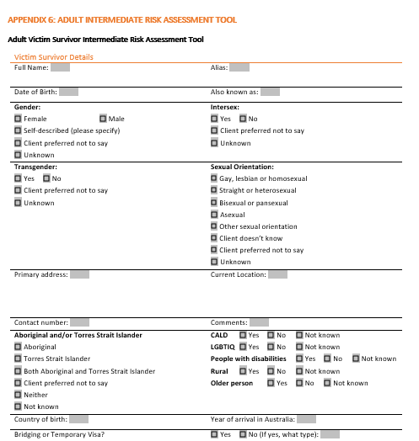
MARAM assessment tools
Tools that support risk assessment at an Intermediate level under MARAM:
Intermediate Tool
Brief Tool
Child Assessment Tool

Slide 13

Intermediate assessment tools
  Questions in the Intermediate Assessment Tool
  are grouped according to:
  Risk-related behaviours being used by a perpetrator
  against an adult, child or young person
  Self-assessment of level of risk
  (adult victim survivor)
  Questions about imminence
  (change and escalation).

Slide 14

Intermediate assessment tools
Risk-factor Question
Reframing
Drug and/or alcohol misuse/abuse
‘Have they recently misused alcohol,
drugs or other substances?’
Common
Presentation
Stalking of victim
‘Have they recently followed you, repeatedly harassed or messaged/emailed you?’
Kept in mind
Emotional abuse
‘Have they been obsessively jealous towards you?’
‘Have they ever threatened to harm the child/children?

Slide 15
Brief assessment tools
This tool has a subset of questions from the Intermediate
Assessment Tool designed to identify serious risk factors.
The Brief Assessment Tool should be used if:
  There is limited time to engage with a patient
  If it is not safe to seek further detail about the family violence beyond high risk factors
  It immediately follows an incident
  If it is during a crisis intervention.

Slide 16
Child assessment tools
The Child Assessment Tool is divided into two sections:
  Questions to ask a mother/carer about a child/young person.
  E.g. ‘Has the child intervened in any incidents of physical violence?’
  Questions designed to ask a child or young person directly.
  E.g. ‘Has your parent/caregiver said bad things to you about your
  other parent/caregiver?’
If it is part of your role, and you have been trained, in some circumstances intermediate assessment may occur directly with an older child or young person.

Slide 17
Structured Professional Judgement model

Slide 18
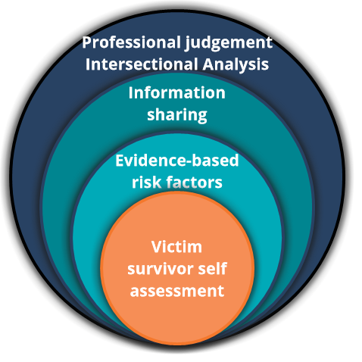
Structured Professional Judgement
The module underpins risk assessment to support determining the level of seriousness of risk and inform risk management responses.

Slide 19
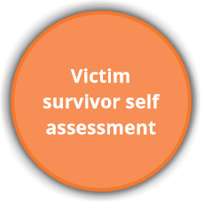
Structured Professional Judgement
Victim survivor self-assessment
This element involves exploring with the victim survivor’s their assessment of their safety and level of fear and risk.
Evidence supports the accuracy of a victim survivor’s assessment of their own level of risk.
If the victim survivor’s assessment of their level of risk is different from yours, it is important that you explore this with them further as this can reveal important protective factors and contextual information that the victim survivor is aware of.

Slide 20


Check your understanding
Why might a victim survivor minimise their risk?
Being afraid that the perpetrator may use further violence following an intervention
Concerns a child may be removed from the home
Perpetrator’s emotional abuse tactics creating uncertainty
Denial or not ready to disclose
All of the above

Slide 21
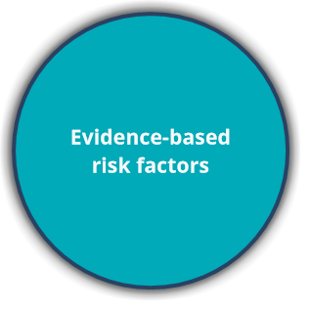
Structured Professional Judgement
Evidence-based risk factors
The MARAM tools support gathering information about the common presentation of the evidence-based risk factors.
Other presentations of the evidence-based risk factors should also be taken into consideration.

Slide 22
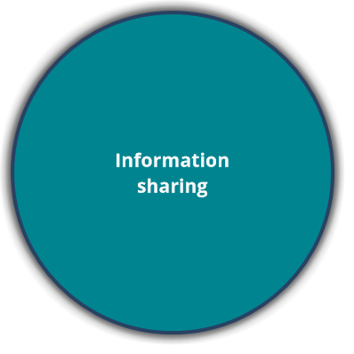
Structured Professional Judgement
Information sharing
Information sharing is about how we all work together as professionals to make sure the whole picture is represented within risk assessment and management.
This means requesting and sharing information from relevant agencies, in accordance with the Family Violence Information Sharing Scheme (FVISS) and Child Information Sharing Scheme (CISS), as well as pre-existing legislation, to inform an understanding of family violence risk.

Slide 23
Check your understanding
Imagine you are a social worker within a hospital. Hospitals are prescribed as Information Sharing Entities (ISE) under the Family Violence Information Sharing (FVISS) Scheme.
When might you consider requesting information from other agencies to inform your understanding of the risk?
When the victim survivor has disclosed but isn’t ready or isn’t in a position to respond to further questions about their experiences of family violence.
When you have information that a perpetrator is currently engaged with another prescribed organisation.
Before family violence has been identified to support identifying if family violence is occurring.
A & B.

Slide 24
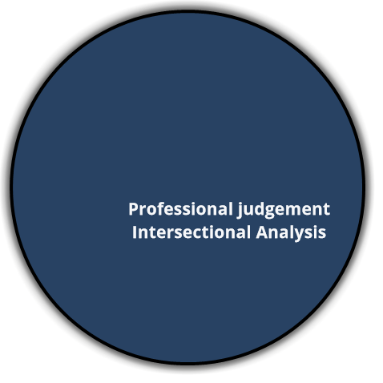
Structured Professional Judgement
Professional Judgement
Applying professional judgement refers to the assessment of the ‘seriousness’ of risk through consideration of:
All information gathered through each component of the Structured Professional Judgement model.
Any protective factors and contextual information relevant to risk.
And an Intersectional Analysis

Slide 25
Structured Professional Judgement
Protective factors
Protective factors are things that may lessen or mitigate family violence risks or build resilience and support recovery where family violence has occurred.
For example, having an Intervention order in place and being adhered to, the victim survivor being employed, supportive family and friends and effective system intervention.
For Aboriginal people, cultural pride and a strong sense of Aboriginal spirituality and community are important protective factors.

Slide 26
Structured Professional Judgement
Intersectional Analysis
Applying an intersectional analysis means giving due weight to service users’ identities and experiences and understanding the impact on risk.
Including understanding:
Barriers to disclosure and accessing appropriate support.
Tactics the perpetrator has used that capitalise on the discrimination and structural inequalities experienced by the victim survivor.
And understanding your own potential biases and reflecting on how it may influence your practice.

Slide 27
Check your understanding
Discriminatory attitudes towards individuals with a disability that result in assumptions that a parent who has a disability has less capacity than someone without a disability can create a level of uncertainty and fear for a victim survivor with a disability and stop them from seeking support.
Which two are examples of a tactic a perpetrator can use which reinforces this discrimination to stop a parent with a disability from seeking support?
No one will believe you if you tell them about the abuse.
Who will take care of you and the children if you leave?
Threatening to report to Child Protection that she is an unfit mother so the children are removed from her care.

Slide 28
Assessment of seriousness of risk

Slide 29
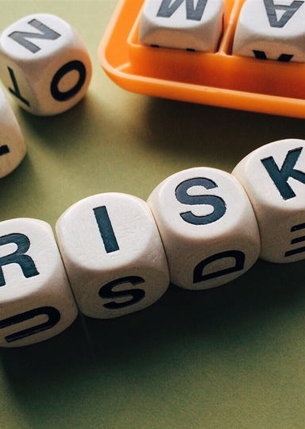
Seriousness of risk
MARAM uses ‘risk ratings’ to describe the levels of risk.
The seriousness of risk will guide the appropriate risk management strategies.

Slide 30

Seriousness of risk
The risk categories used under MARAM
Serious Risk and Requires Immediate Protection
At Risk
Elevated Risk
Serious Risk

Slide 31
Misidentification of the perpetrator and victim survivor

Slide 32

Misidentification of the perpetrator and victim survivor
Misidentification is where a victim of family violence is categorised as a perpetrator or where a perpetrator has misrepresented themselves as a victim of violence.
Incorrect identification has serious implications for the safety and wellbeing of victim survivors.

Slide 33

Misidentification of the perpetrator and victim survivor
Why does misidentification occur?
Perpetrators of family violence report being victim survivors to manipulate services, including police. Presenting in this way is also consistent with ‘victim stance’ thinking that many perpetrators adopt to justify and excuse their behaviour.
When a victim survivor uses self-defence or violent resistance during an incident of family violence.
Perpetrators take advantage of discriminatory attitudes and deliberately misrepresent a victim survivor, such as in relation to the victim survivor’s mental health or drug usage.
Barriers to victim survivors communicating effectively with police and service providers - including language, trauma, fear of reprisal - may result in victim survivors not being able to provide a full account of the situation.
Heteronormative beliefs and incorrect assumption can lead to misidentification in same-sex and/or gender diverse relationships.

Slide 34

Misidentification of the perpetrator and victim survivor
At an intermediate level, a practitioner should be aware of the possibility of misidentification.
Where there is uncertainty, assistance should be sought from a specialist family violence service or Men’s Referral Service.

Slide 35
Module 3 summary
Evidence-based risk factors
MARAM risk assessment tools
Structured Professional Judgement model
Assessment of seriousness of risk
Misidentification of the perpetrator and victim survivor

Slide 36

Quotes from victim survivors
I ‘was incredibly amazed and relieved to hear a support worker saying ‘yes we’re familiar with that behaviour’ … I cannot tell you the relief it was to finally, after … years have my experiences validated by an understanding voice’.
Anonymous
(Royal Commission into Family Violence: Report and recommendations, Vol II)
‘That was the first time I realised I had been in a domestic violent relationship. The worker ... had a questionnaire which had a series of questions about our relationship … After completing the questionnaire, the worker said I was in a domestic violent relationship.’ Jessica Morris
(Royal Commission into Family Violence: Report and recommendations, Vol I)
‘Support workers, they listen, validate, support and advise. For someone who has never been down the path before this is so helpful’. Anonymous
(Royal Commission into Family Violence: Report and recommendations, Vol II)

Slide 37

Reflection
After undertaking any form of training, it is always important to reflect on these questions:
  How might I apply new knowledge and skills?
  What does this content reveal about my work responsibilities or role that I didn’t know before?
  What can I do better as a result?
  What other knowledge or experience does this enhance?
  What further training do I think I need?

Slide 38

Self-care
Responding to family violence can have an impact and at times be overwhelming
Self-care should be a part of your work
Self-care is a shared responsibility between individuals, teams, organisations and systems
Self-care is about knowing and accessing the professional supports available and prioritising what works for you

Slide 39
Thank you

