Slide 1





Strengthening
Hospital Responses to Family Violence
Responding to children experiencing
family violence
Notes:
Instructions for facilitators:
It is strongly recommended that facilitators seeking to deliver this module are experienced in working with children experiencing family violence or are co-presenting with another facilitator who is experienced in this area.
This training has been tailored specifically for the clinical operating environment within the health sector and covers the MARAM practice expectations for staff groups assigned sensitive practice responsibilities as set out in the Workforce Mapping for MARAM Alignment Guide.
The Royal Children’s Hospital has co-designed this module to address additional needs of paediatric patients.
It is assumed that people attending this session will have completed Sensitive Practice module and have a good understanding of family violence and how to apply sensitive practice
This is not considered to be a paediatric specialist module, rather supplementary information if staff working at a sensitive practice level are required to respond to children experiencing family violence, for example in general wards or emergency departments.
Welcome participants
Introductions
Suggested facilitator dialogue:
Welcome to the Strengthening Hospital Responses to Family Violence Supplementary Module- Responding to children experiencing family violence
We wish to acknowledge the traditional owners of our land, the people of Kulin Nation and pay our respect to elders past, present and emerging.
We also wish to acknowledge victim survivors of family violence, particularly women and children that have been killed in the context of family violence. We hope what is presented in this training is respectful to their individual experiences.
Family violence is a complex and sensitive topic, we want to ensure that our interactions are supportive and provide everyone with the opportunity to participate.
To support a safe learning environment we ask you to commit to the following group agreement:
You are welcome to take a break at any time during the training without asking permission
One person at a time to speak
De-identify examples from practice to protect confidentiality
Acknowledge that there will be people in their room with their own experience of family violence
This presentation will inform you of how to access support if you feel emotionally impacted by anything covered in training

Slide 2








Specialist Family Violence Services
1800 737 732
1800 551 800
1800 015 188
1800 806 292
1800 105 303
1800 755 988
LGBTIQ
1300 766 491
1800 542 847
Notes:
Instructions for facilitators:
Refer to slide and suggested facilitator dialogue below.
Suggested facilitator dialogue
Discussing Family Violence can be distressing, particularly for people who have been impacted by violence.
If the discussion today causes you any concern for yourself or a colleague or family member or friend, please contact one of these services for support. These are listed in your notes as well as local and workplace services you can access.
Kids Helpline: Anytime, Any Reason
1800RESPECT and Safesteps are 24 hour SACL is an after hours service.
If you feel you need to discontinue at any time, you may do so, but we encourage to reach out to available supports.

Slide 3

LEARNING OBJECTIVES
  Impact of family violence on children and young people
  Recognising and responding to children and young people affected by family violence
  Special considerations when responding to children/young people
  Legal responsibilities
Notes:
Instructions for facilitators:
Outline training objectives on the slide and suggested facilitator dialogue below.
Suggested facilitator dialogue:
The purpose of this training is to ensure health professionals have an understanding of the impact of family violence on children and young people, how to appropriately recognise and respond to children and young people affected by family violence
At the conclusion of this session, participants will understand the following;
Impact of family violence on children and young people
Recognising and responding to children and young people affected by family violence
Special considerations when responding to children/young people
Legal responsibilities

Slide 4
The Family Violence Protection Act 2008 (Vic) defines ‘family violence’ as:
A behaviour by a person towards a family member that is
physically or sexually abusive
emotionally or psychologically abusive
economically abusive
Threatening or coercive
Controlling or dominating
causes fear for own safety and/or safety of others
This definition also includes behaviours that cause a child to witness, hear or otherwise be exposed to the effects of family violence.
Family Violence Protection Act 2008 (Vic)
Definition of family violence
Notes:
Instructions for facilitators:
Talk through the definition
The slide is animated so ‘causes fear’ appears on second click
Suggested facilitator dialogue:
There are many different forms of family violence
You will recall family violence constitutes a broad range of behaviours, the core of which causes fear in another individual.
Most important for this module, is part 2 of this definition which defines family violence as “behaviour by a person that causes a child to hear or witness, or otherwise be exposed to the effects of family violence.”
Key message: Family Violence in all forms impacts on children of all ages.

Slide 5

One child almost every fortnight is killed by a parent or step-parent (according to a national study reporting from 2000-2012)
Source: Brown T et al. 2019
Children are to be recognised as victim survivors of family violence in their own right, whether they are directly targeted by a perpetrator, or being exposed to or witnessing violence or its impacts on other family members
Exposure to violence can also include:
  • Hearing violence
  • Being aware of violence or its impacts
  • Being used or blamed as a trigger for family violence
More than half of the women who experience family violence have children in their care when the violence occurs
Source: 2016 Personal Safety Survey (ABS, 2017)
Children and family violence
Notes:
Instructions for facilitators: Refer to the slide and suggested facilitator dialogue
Children are to be recognised as victim survivors of family violence in their own right, whether they are directly targeted by a perpetrator, or being exposed to or witnessing violence or its impacts on other family members.
Children and young people do not have to be physically present during violence to be negatively affected by it, or to be considered victim survivors.
Exposure to violence can include:
• Hearing violence
• Being aware of violence or its impacts
• Being used or blamed as a trigger for family violence
• Seeing or experiencing the consequences of family violence, including impacts on availability of the primary caregiver and on the parent-child relationship.
Children are present in many family violence situations and are therefore subject to physical, emotional and social impacts, including psychological trauma, disrupted attachment, delays to development, lack of predictability and stability
Family violence should be seen as an attack on the mother child relationship because of the effect this has on her ability to parent
Children and their mothers/carers are especially vulnerable if the child has a disability
Family violence and the physical or sexual abuse of children are highly correlated
Family violence was a factor in 80% of child deaths known to child protection in 2013 (Commission for Children and Young People, 2013)
Health professionals have a duty of care to report to Child Protection when there is a reasonable belief that a child has suffered, or is likely to suffer significant harm from physical or sexual abuse or exposure to it
An average of 20 filicide incidents was recorded each year in Australia between 2000–01 and 2011–12 Brown T et al. 2019. Filicide offenders. Trends & issues in crime and criminal justice no. 568. Canberra: Australian Institute of Criminology. https://www.aic.gov.au/publications/tandi/tandi568
Brown T, Lyneham S, Bryant W, Bricknell S, Tomison A, Tyson D & Fernandez Arias P 2019. Filicide in Australia 2000–2012. A national study. Report to the Criminology Research Advisory Council. CRG 52/14–15. Canberra: Australian Institute of Criminology
Key message: Children and young people who experience family violence and sexual assault can experience long term health impacts and trauma
See ACES study for more information
https://www.cdc.gov/violenceprevention/aces/index.html

Slide 6

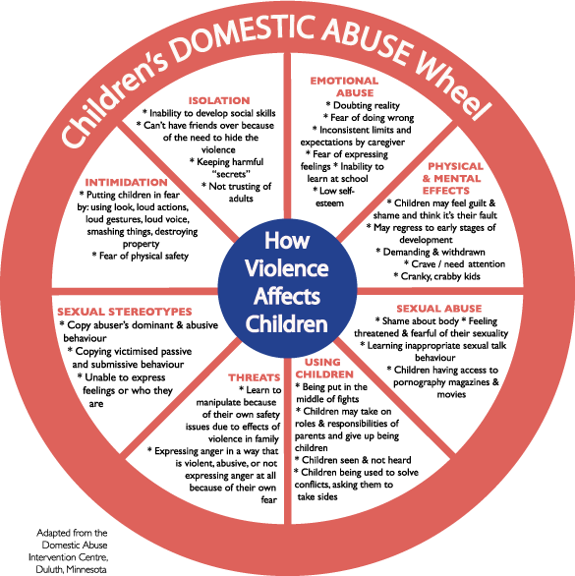
Impacts of Violence on Children
Notes:
Instructions for facilitators: Refer to the slide and suggested facilitator dialogue
The Power and Control Wheel is a tool that helps explain the different ways an abusive partner can use power and control to manipulate a relationship. This is an adaptation to demonstrate how children are impacted
Children can be used as sources of further control including threatening to take children away
Family violence is coercive control and engages systems to collude in the violence
Children may continue to have contact with both parents
Consider other forms of marginalisation- intersectionality, CALD children, Aboriginal children, children in out of home care.
It is good practice to work on the assumption that where child abuse or neglect is occurring, DFV is also occurring.
This encourages an assessment of the father’s influence on child and family functioning. Without this, blame may be attributed to the mother, and the father’s parenting behaviours (good and bad) can go unrecognised.
Common Comorbidities:
Child abuse and family violence
Childhood sexual assault and family violence
Aggression and persisting struggles with mental health in infants, children and young people, including detrimental effects on social and emotional development
Additional information:
The collection of statistics by RCH social workers based on referrals that have either previously identified family violence or where family violence has been identified by social work during contact has shown that FV work within a Paediatric setting is nuanced, complex work.
Demographics of referral sources and patient presentation:
The majority of patients (57%) were aged 5 years or under
Emergency (38%) and General Medicine (12%) units represented over half of cases entered into flow sheet
Medical (45%) and nursing (37%) staff were the referral source in four out of five cases
Family violence was identified as being a current issue in 62% of cases, and historical in 33% of cases
Demographics of perpetrators of family violence in a Paediatric setting:
The patient’s father, step-father, or mother’s partner was the alleged perpetrator in 82% of cases
The patient’s mother, or father’s partner, was identified as the alleged perpetrator of violence in 8% of cases
Intimate partner violence is overwhelmingly the most common form of family violence presenting at RCH (82% of cases)
The patient, or patient’s sibling, were identified as the perpetrator of violence in 8% of cases
Alleged perpetrators were male in 78% of cases
Healey, L., Humphreys, C., Tsantefski, M., Heward-Belle, S., Chung, D., & Mandel, D. (2018). Invisible Practices: Working with fathers who use violence. Practice guide. Sydney, NSW: ANROWS.
ACES - https://aifs.gov.au/cfca/publications/childrens-exposure-domestic-and-family-violence/effects-childrens-exposure-domestic

Slide 7

‘Age of consent’ for children
and young people
The law sets restrictions around having sex, sexual touching or performing sexual acts in front of children and young people, even if the child or young person agrees
  Under 12 years old: No-one can engage in sexual behaviours with a child this age
  12 to 15 years old: Must be within 2 calendar years in age
  16 to 17 years old: Must not be caring for or supervising the young person e.g. a teacher, youth worker or foster carer (unless they are married to each other)
Notes:
Instructions for facilitators: Refer to the slide and suggested facilitator dialogue
We know many children and young people are the victims of sexual abuse and that sexual abuse commonly occurs in conjunction with family violence and is perpetrated by people known and trusted.
There may also have been childhood experience of sexual assault.
The law in Victoria sets clear age limits for when you can legally consent to have sex. This is called ‘age of consent’.
A person can be charged with a sexual offence if they perform a sexual act that breaks these age limits, even if the younger person agrees to it.
The age of consent for same-sex and gender-diverse relationships is the same as it is for heterosexual relationships.
Sex can be complicated by people taking and sending digital pictures or video. If this is of someone who is or appears to be a minor (under 18) it can be child pornography if the picture depicts sexual behaviour or is in an indecent context.
Caution: Not advisable to ask direct questions about sexual assault; if a disclosure is made, discourage further details and suggest referral to a professional experienced in dealing with sexual assault (i.e. VFPMS, CASA or Gatehouse)
Note: there is a SHRFV Module: Responding to Sexual Assault
Key message: Clinicians need to be aware of ‘age of consent’.

Slide 8
Observable signs of trauma-children
Infants | Baby and toddler | School-age child | Adolescent
Poor growth & neural development* | Unsettled baby (excessive crying, sleep disturbances, irritability | Psychosomatic symptoms – abdominal pain, sleep disorders, frequent illness | Poor health care, poor management of chronic conditions
Low birth weight | Feeding problems (incl. failure to thrive) | Regressive behaviours, e.g. bed-wetting | Physical injuries or chronic pain
Pre-term birth | Physical injury | Poor adherence to management of chronic conditions, e.g. asthma, diabetes | Eating disorders Self-harm or suicidality
Injuries sustained via assault to mother (e.g stomach being punched) | Disorganised attachment (e.g. avoidant gaze, easy startle response) | Emotional lability Withdrawn, aggressive or anxious behaviours may present as conduct disorder or ODD | Depression, anxiety and other mental health presentations
 | Delayed developmental milestones e.g. language development | Poor concentration, deteriorating school performance, social isolation | Substance use, truancy and other risk taking behaviours STDs, early pregnancy, violent partners
Notes:
Instructions for facilitators: Refer to the slide and below dialogue.
Give participants the handout: Signs of Family Violence Across the Life Span
Suggested facilitator dialogue:
These signs may indicate that family violence is occurring.
Need to acknowledge of these signs can occur differently across a person’s lifespan, from childhood, adolescence through to adulthood and old age.
These observable signs of trauma have been taken from Appendix 1 MARAM Practice Guide 2, and is accessible through the following link: https://www.vic.gov.au/maram-practice-guides-and-resources
The first step is to identify signs and know when to ask. For your team, you may notice these signs within the patient or their siblings.
The impacts of family violence can look different at different ages and stages of a child’s development. This slide is an example of the wide range of impacts and presentations in the paediatric setting, from in-utero right through to adolescence.
These signs are not necessarily unique to family violence and may be seen for a variety of other reasons, however, they are clear signs which should be part of a differential diagnosis.
The common theme of all these presentations is the effect on the child's mental health and parent-child attachment.
This could be seen in an unsettled baby, a child with regression of developmental stages or in a teenager with poor & deteriorating compliance e.g. with diabetes management.
It is not recommended that everyone is necessarily asked about FV, but if certain signs are present, we want you to be alert to them and to enquire further.
In particular, if you are supporting a family and have provided every support to them to assist their child in attending school and the parents aren’t compliant with this, it is a sign to flag for further discussion.
Looking at this table above are there particular ones that stand out for you that are evident within your experience or that surprise you or that you would like to talk further about?

Slide 9
Notice the signs-parents/caregivers
  Parental distress out of keeping with the severity of child/young person’s illness
  Parental reluctance to discharge
  Frequent non-attendance or rescheduling
  Frequent presentations for a child or young person with no clear health concern
  Intrusive partner in consultations – unable to speak alone.
  Infrequent visiting
  Aggressive or controlling relationships dynamics between parents observed by clinician
  Poor mental health – anxiety, depression, PTSD, inability to retain information
  Alcohol and other drug use
  Physical signs including unexplained injuries
Notes:
Instructions for facilitators: Refer to the slide and below dialogue.
Give participants the handout: Signs of Family Violence Across the Life Span
Suggested facilitator dialogue:
We may also notice signs in parents attending with children/young people that alert us to possible concerns.
Any of these signs in a child, young person or parent should trigger a clinician to begin a sensitive enquiry.
Key message: Parental signs should be taken into consideration when working with children experiencing family violence

Slide 10
Behaviour indicating non-return of child
Child intervention in violence
Sexualised behaviours towards a child by perpetrator
Child as victim in other forms of harm
Change in behaviour not explained by other causes
History of professional involvement and/or statutory intervention
Professional and statutory intervention
Undermining the child-parent relationship
Exposure to family violence
MARAM Evidence based
risk factors
Risk factors specific to children
Notes:
Instructions for facilitators: Refer to the slide and suggested facilitator dialogue
Suggested facilitator dialogue:
These risk factors reflect the current and emerging evidence-base relating to family violence risk as defined by the MARAM Practice Guide (Family Safety Victoria, 2019).
Risk factors specific to children caused by perpetrator behaviours:
Exposure to family violence
Sexualised behaviours towards a child by the perpetrator
Child intervention in violence
Behaviour indicating non-return of child
Undermining the child-parent relationship
Professional and statutory intervention
Risk factors specific to children’s circumstances:
History of professional involvement and/or statutory intervention
Change in behaviour not explained by other causes
Child as victim in other forms of harm
Not all professionals need to ask about each risk factor — but clinicians do have a role in understanding and identifying risk factors
Key message: knowledge of risk factors underpins a shared understanding of family violence, and ensures clinical staff use information gained through engagement with patients to identify indicators of family violence risk and affected family members.

Slide 11
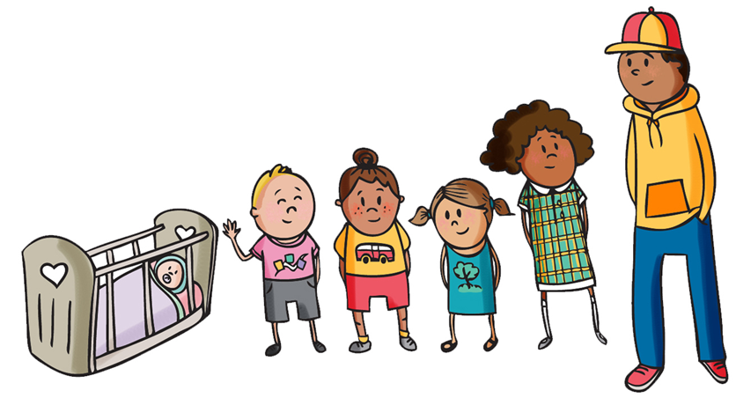
Questions to ask yourself
What deters you from having a conversation about family violence with a parent – and with a child or young person?
What challenges are unique to responding to a child experiencing family violence?
Notes:
Instructions for facilitators: Refer to the slide and suggested facilitator dialogue
Suggested facilitator dialogue:
What deters you from having a conversation about family violence with the parent of a child or young person?
Suggested responses:
A belief that father is a protective figure
High work loads and lack of time
Lack of awareness of risks and signs of FV
Not knowing what questions to ask and how to support or refer for help
Not thinking family violence is relevant to the child/young person’s health care
Embarrassment about intruding / discomfort about asking
Concern about how to handle a disclosure
Concern about placing the woman at heightened risk
Concern about losing a parent, child or young person’s trust if child protection become involved
Feeling helpless at not being able to provide a solution
Concerns about documenting family violence in a child/young person’s medical record
Own safety and wellbeing
Impact on patient discharge
What challenges to inquiring about family violence are unique to responding to children?
Sometimes women experiencing family violence will be reluctant to be separated from their children to be interviewed.
The literature suggests it is safest not to inquire in the presence of a child above the age of 2 years.
Child care arrangements may need to be made
You can’t be sure who the offending parent is
Both parents have the right to access with their child (unless there is a Court order)
Both parents have the right to access their child’s health records (discretion can be used with older adolescents)
Siblings' safety and wellbeing should also be considered even if they are not present.
Child or young person has been conditioned / threatened to ‘keep secrets’ / fear of talking
The potential conflict between giving a woman choice and the need to protect the child/young person – Child Protection responsibilities
Identifying the adolescent who uses violence
Adolescent who doesn’t want their parent involved
Key message: Every time you don’t ask is a missed opportunity.

Slide 12
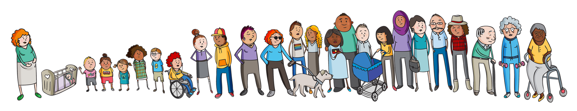
  Privacy-never discuss in the presence of other family members, including partners and children over the age of 2
  Be honest about limits of confidentiality
  Create a safe physical and emotional environment
  Tune in to non-verbal cues and offer several opportunities to talk
  Use framing statements to start the conversation
What can we do to overcome barriers?
Notes:
Instructions for facilitators: Refer to the slide and below dialogue.
Suggested facilitator dialogue:
Discuss: What can we do in our practice at this hospital to make it easier for people to disclose family violence and seek support?
If you’ve noticed signs of family violence, before inquiring further, ask yourself whether the conditions are right to proceed:
Is your patient/parent alone?
Are there children present? If they are aged over 2 they might have the verbal skills which could heighten the risk if they repeated information to other people outside the conversation, eg. the father or a grandparent
Can your conversation be overheard by family/friends?
Is it a suitable time to ask – e.g. is the patient in pain, is mother anxious about surgery etc
Prompting questions are open questions, to elicit a response, without pushing too far too quickly .
Building trust is also required and we know that people might not disclose the first or first several times they are asked, especially in the absence of a strong relationship with a clinician, so if there are flags, ask again at subsequent visits and create opportunities for disclosure.
It is very important to ‘introduce’ your conversation and normalise and contextualise FV as an issue worth discussing as part of their health care.
Key message: A safe physical and emotional space is an important aspect of sensitive inquiry

Slide 13
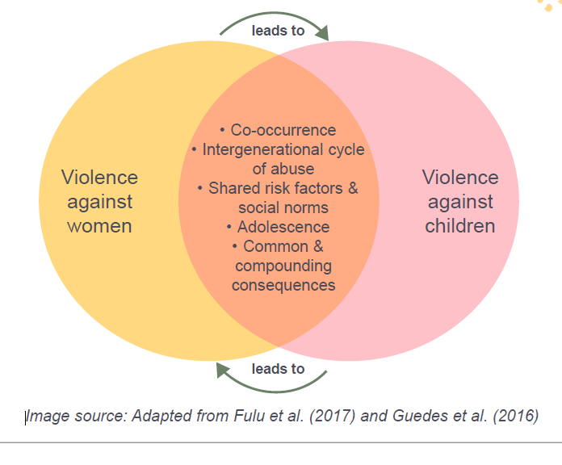
  Legislative:
Sensitive Practice
Prevention of Violence Against Women
Rights of the Child in Healthcare
Best interest of the child principle
Child Safe Standards
Mandatory Reporting
Principles of Child Safe Family Violence Practice
Notes:
Instructions for facilitators: Refer to the slide and suggested facilitator dialogue
Questions to reflect on, identify, practice and/or document:
• Do you meet with both parents separately?
• What checks and measures are in place to ensure info given about family dynamics is accurate for the experience of all household (FV perpetrator tends to set the scene and paint a view of his partner for us)
• Do practitioners ask if a case of child abuse is being presented in a way which makes the father invisible?
• Do practitioners routinely ask for DFV when they respond to child abuse?
• Do practitioners routinely ask for child abuse when they respond to DFV? Do we accommodate the concerns or wishes of one parent over another – is this based on their role in a child’s daily health and well being – or is it based on a covert threat and intimidation from perpetrator.
Children often have deeply ambivalent feelings about their fathers, and they need to know that this is OK.
Implications for FV work:
Central question should be around the child’s experience of health care
FV responses in Paed emergency settings and general medicine teams need resourcing
Identifying at risk infants and children presenting as “vulnerable children” and enquiring into FV co-occurring with child abuse
Children have their own unique experiences of FV, that may differ from sibling to sibling
Key message: There are numerous layers of global, national, local and organisational best practice policy that supports best practice principles when working with children due to the increase in evidence around impacts of family violence on children’s health as individuals and community members in their own right.
Key message: children exist and thrive within family /kin groups. When primary attachment/caregiver bond is interrupted then child at risk as well.

Slide 14
It is difficult to provide a standard response to complex family issues. Determining the best response needs to be done in consultation with your team /supervisor/family members and care team.
Some practice examples can include:
Respect children's rights to ask a violent parent not to visit
Listening to silent voices as part of assessment - person using violence often tells the story and children have long been silent victims
Don’t lose sight of the child, keep parenting choices accountable
A child will monitor your response to gauge their own safety
Promote a child’s resilience
Principles of Child Safe Family Violence Practice:
Examples in practice
Notes:
Instructions for facilitators: Refer to the slide and suggested facilitator dialogue
All doors should be the right door for children to feel safe to seek support and have access to trauma informed care if they seek to disclose their experiences.
Family violence impacts children’s health
A child’s experience is unique to their parents
Children can’t leave the relationship, therefore working with families and children where the relationship is still intact, or separated, or on the verge of separation or long term separation
Promote a child’s resilience
Partnering with the non violent parent
Parenting choices
Support and educate their family and community
Talking proactively to young men and women about respectful intimate relationships
Promote children's relationships with safe and supportive caregivers
Examples in practice:
Children's rights to ask a violent parent not to visit
Listening to silent voices as part of assessment - person using violence often tells the story and children have long been silent victims
Experiencing family violence is a health issue. Thinking about good and bad people is replaced by good and bad behaviour and impacts. Harm is to be avoided at all costs.
Care is the fundamental guiding principle of health and health systems.
Primary prevention is a way of giving care in advance.

Slide 15
Responding in a Paediatric setting
Notice the signs
Refer back to observable signs of trauma-you may notice these signs within the patient or their siblings.
Once you have noticed the signs it’s your duty to do something
Parents:
“Having an unwell child can be stressful, how are you and your partner coping?”
Child:
Provide supportive statements about you what you noticed, for example; “I noticed that … That’s not ok, no one deserves to be spoken to/treated/like that”
“Has anything bad, sad or scary happened to you or at home recently?”
Ask sensitively
Notes:
Instructions for facilitators: Refer to the slide and suggested facilitator dialogue
Once you have noticed the signs it’s your duty to do something
Disclosure is the tip of the iceberg.
Disclosure of family violence is NOT the aim - responses and support are needed no matter if a disclosure is made.
A child may be testing to see if its safe to tell someone. They will be watching your response if you notice a sign.
Your response is the intervention itself
Provide supportive statements about you what you noticed, for example, “I noticed that … That’s not ok, no one deserves to be spoken to/treated/like that”, “You are not to blame”, “Would you like any help with this now?”
If working with parents, partner with the non-violent parent
Note both parents’ actions and how this behaviour impacts on the child’s healthcare. Does it contribute or does it manufacture distraction?
If you have not engaged the child or young person it is unlikely you will get a good response. Need to spend time to build trust before embarking on a sensitive inquiry.
Children and young people’s non-verbal cues, can be observed , for example – the way a child wriggles or glances at his parent when family violence or family relationships are mentioned. You could ask some useful general questions and gauge the child/young person’s response - like you do every day.
Use non-leading questions which focus on the child or young person's experience (and don’t require them to ‘tell tales’ on their parents):
What’s it like at home?
Who lives there?
Do you ever have friends over?
How does everyone get along at home?
Who helps you with your homework?
What happens if you don’t do what you’re told?
You look a bit worried when we talk about going home.
Would you like to go home?
Are you worried about something at home?
Are you worried about anyone else at home?

Slide 16
Responding in a Paediatric setting
Respond respectfully
A child may be testing to see if its safe to tell someone. They will be watching your response if you notice a sign.
“You deserve to feel safe”
“You’re not to blame”
“Would you like any help with this now?”
Ask patient/parent: “Are you safe to go home?”
Respond to risk
Ask Yourself:
Immediate risk to patient or family members?
Disability? Under 6 years? Complex medical needs?
Escalation of violence?
Threats to children, pets or property?
Mother pregnant or new birth?
Recent separation?
What does the patient/family want now?
Is immediate action required?
Notes:
Instructions for facilitators: Refer to the slide and suggested facilitator dialogue
If you or another professional has expertise and training in working with children, and it is safe, appropriate and reasonable in the circumstances, you can speak with the child or young person directly about the signs you have observed.
Assess all children and young people in ways that are appropriate to their stage of development.
When talking to younger children it is useful to physically get down to their level, consider your tone of voice, and speak gently and reassuringly. You might start your conversation by acknowledging that they may be nervous or confused about speaking to an adult they don’t know, or don’t know very well. Reassure them that they will not be in trouble and you won’t judge them, no matter what they tell you.
Young people, especially young women, might experience violence in the family home and/or from a partner outside the home so it is important to obtain the name of the suspected perpetrator or adolescent who may be using violence and their relationship to the victim survivor (MARAM Responsibility 2 Practice Guide)
Further information on assessing risk for children and young people can be found in the Assessing Children and Young People Experiencing Family Violence Practice Guide.
Further questions to assist in identifying risk:
Have you ever had to protect or be protected by a sibling or other child in the home?
Has your parent/caregiver said bad things to you about your other parent/caregiver?
Have you ever tried to stop your parents/caregivers from fighting?
Are you scared of either of your parents/caregivers or anyone else in the home?

Slide 17
Responding in a Paediatric setting
Social Work
1800RESPECT (24/7 national hotline)
Safe Steps (24/7 crisis line) 1800 015 188
Gatehouse 9345 6391
DHHS Child Protection (priority line) 9843 5422
Employee Assistance Program
Referral
Documentation
Have you documented in patient’s medical record?
Notes:
Instructions for facilitators: Refer to the slide and suggested facilitator dialogue
Collaborate: YOU DON’T NEED TO DO THIS WORK ON YOUR OWN.
Sharing information increases safety if done in the right way.
There are also legitimate concerns about documenting family violence in a child/young person’s medical record, which both parents may have access to under Freedom of Information. As more hospitals use electronic medical records and use tools which allow patients to access their records (eg: Royal Children's Hospital has a Patient Portal) this will be even more challenging. This is an issue that has not been resolved in many paediatric setting worldwide.
While you might be tempted to say to a child or young person, ‘Trust me, I won't tell anyone' it is important not to do this, as you might need to involve statutory services, for example Child Protection, without their consent to do so.
‘You deserve to be safe so I may need to speak with someone else if you tell me something that makes me concerned for your safety.’
Key message: Consult with local paediatric team or FV services when:
You have reason to believe this child or caregiver is not safe and requires escalation of care (see flowchart on following slide).
At any time you feel uncomfortable managing the situation and need advice on how to proceed.

Slide 18

  What risk factors have I identified?
  What level of risk does the person experiencing
  violence identify?
  What do they want to happen?
  Is urgent action required?
  If not urgent, is any other action required?
  Are there any legal orders?
  Do I need to report to Child Protection?
Respond to Risk
Notes:
Instructions for facilitators: Refer to the slide and suggested facilitator dialogue
The question is always, is it safe for the patient to go home? Your course of action should be informed by the expressed needs of the patient/family, along with your knowledge of the situation and of risk factors
An action plan should be developed in collaboration with the patient/parent. [Refer to hospital procedures, Clinical Practice Guidelines, Child Protection, Victorian Forensic Paediatric Medical Service or Social Work Dept].
If an assessment is made that it is safe for the patient and parent to go home, a basic safety plan can be developed with them. This can include:
Referral to a family violence outreach service or generalist support service for follow up support
Discussion regarding what the patient/mother will do if violence escalates i.e. where she will go, how she will get there, and what does she need to take with her. (incl. essential documents, children's medication, comfort items for children, for example)
How do we keep the mother/patient safe in the hospital? Do we need to implement restrictions (visits and non disclosure of information), safety plan?
Identification of all members of the household that might need to be considered within the action plan i.e. children and young people, other vulnerable household members, pets, a support person
Consider offering a follow up appointment, or contact from the hospital Social Worker at a future date
If you assess it is not safe for the patient or parent to return home or risk factors require further assessment immediate action is required.
A referral to the social work department or to a specialist family violence crisis service (Safe Steps) should be provided.
These services will be able to provide a more comprehensive risk assessment, safety planning, advocacy and referral to crisis accommodation as appropriate.
Key message: Always ask yourself, is it safe for the patient to go home?

Slide 19
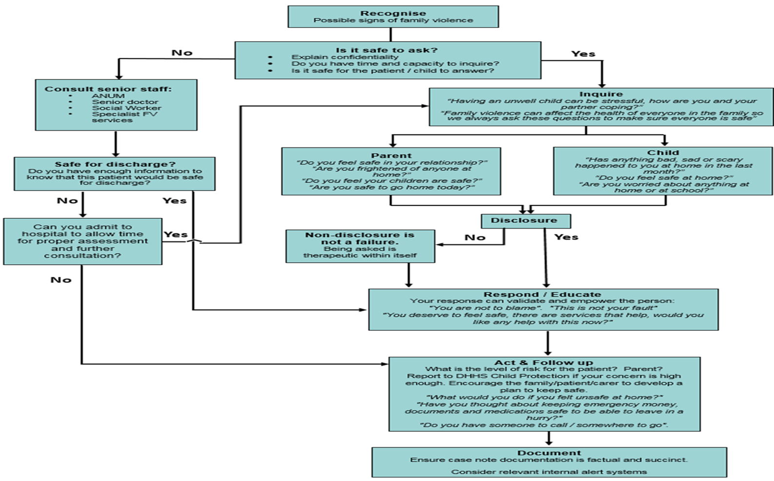
Statewide Clinical Practice Guidelines
Notes:
Instructions for facilitators: Refer to the slide and below dialogue
Note: This slide could be amended to reflect your hospital’s referral pathway for internal and external services noting where 24/7 assistance is available
Handout: This flowchart should be provided as a handout for better visibility.
Suggested facilitator dialogue:
This guideline has been adapted for state-wide use with the support of the Victorian Paediatric Clinical Network
Links to fact sheets and CPG:
https://www.rch.org.au/kidsinfo/fact_sheets/Family_violence/
https://www.rch.org.au/clinicalguide/guideline_index/Family_Violence/

Slide 20

  Infant NICU Transfer
An infant of a rural family is born c/section @ 34/40 with Pierre Robin Syndrome planned transfer at birth for surgery. Long admission, 1st child for family. Punjabi background having lived in Australia for 10 years. Mother: clerical. Father: GP
No psychosocial issues known
Infection acquired from surgery.
Father reports that the pregnancy was managed poorly, mother’s mental health was declining and says he doesn’t want staff talking to mum with updates as she “needs to rest”.
The paternal grandparent drives mum to RCH after a day delivery from regional area to Melbourne. Parents stay on ward and paternal grandmother stays in Melbourne.
What are the ‘red flags’ in this scenario that would concern you?
Who would you discuss concerns with?
Would a Code Grey (distress or emergency code) be appropriate for this situation, if not when would you consider a code grey?
Case Study 1
Notes:
***3 case studies provided, choose 1 to review***
What are the ‘red flags’ in this scenario that would concern you?
Age of infant
Father telling story
Isolation of mother
CALD
Inability of staff to get mother on her own
Multiple team involvement meaning loss of information and first assessment being taken as current situation and difficult to challenge.
Who would you discuss concerns with?
ANUM, SW, treating team, 1800 RESPECT, InTouch
Would a Code Grey be appropriate for this situation, if not when would you consider a code grey?
Use own emergency management procedure.

Slide 21

8 y/o to Gen Med via GP referral
An 8 year old boy presents as quite unwell needing to see specialist urgently. He has been brought in by his mother and his 4 year old sibling. Presenting with eczema, bed wetting and school refusal.
Dad is verbally aggressive towards mum/child hurrying up as they are late to the appointment and calling mother “useless”, and the child, “useless just like your mother”.
Father then becomes aggressive with admin staff on arrival in outpatient clinic. Admin staff report feeling unsafe to admin coordinator, who intervenes and talks to Dad but does not push distress button.
Dad leaves with the 4 year old sibling and tells mother and child to find their own way home. Mum and child stay in clinics. Security then advise admin clerks they had an incident in the car park where father was pushing mother into the car and yelling at her.
What are the ‘red flags’ in this scenario that would concern you?
Who would you discuss concerns with?
Would a Code Grey (distress or emergency code) be appropriate for this situation, if not when would you consider a code grey?
Case Study 2
Notes:
***3 case studies provided, choose 1 to review***
What are the ‘red flags’ in this scenario that would concern you?
Fathers parenting choices of verbal abuse towards mother in front of children
Age of sibling and child- and impact of family violence on social and emotional health and wellbeing
Medical issues including regression in behaviours indicating trauma response
Non school attendance and lack of services in place to keep an eye on children
Father’s behaviour towards staff- aggression risk
Father’s behaviour towards sibling in his care while escalated and threatening to harm family
Who would you discuss concerns with?
Coordinator, ANUM, medical team, security, outpatient social work
Would a Code Grey (distress or emergency code) be appropriate for this situation, if not when would you consider a code grey?
Use own emergency management procedure

Slide 22
16 year old Adolescent in Emergency Department - violent towards parent and sibling
A 16 year old young woman is brought into Paediatric Emergency Department by police. She has frequently presented to the Emergency Department. A parent attends the ED when informed of her daughter’s arrival with police who confirm she has been a missing person for four days. Mum discloses she is a single mother who wants to relinquish care of the young woman. The young person is violent towards mum and her younger sibling who often have to hide in bedrooms during the adolescent’s behaviour escalations.
There are co-occurring medical and behavioural issues including autism and ASD.
The young person is poly-substance using and self-harming and is non-engaged as she is constantly on her mobile with her boyfriend who is demanding to speak to a nurse to confirm her whereabouts.
What are the ‘red flags’ in this scenario that would concern you?
Who would you discuss concerns with?
Would a Code Grey be appropriate for this situation, if not when would you consider a code grey?
Case Study 3
Notes:
***3 case studies provided, choose 1 to review***
What are the ‘red flags’ in this scenario that would concern you?
Safety of mother and sibling
Previous history of sexual assault?
Previous history of family violence in parental relationship?
Multiple teams involved high risk of losing psychosocial information
Complexity gets minimised and doesn’t get escalated
Disagreement of definition of FV- is violence against parents FV- emerging field of best practice in this space.
Preventative health care around respectful relationships
Who would you discuss concerns with?
Add in appropriate ED procedure
Would a Code Grey be appropriate for this situation, if not when would you consider a code grey?
Use own emergency management procedure

Slide 23

Mandatory reporting
Children, Youth and Families Act (VIC) 2005 Some groups of professionals, including doctors and nurses are mandated to report to Child Protection when they form a reasonable belief that a child has suffered, or is likely to suffer significant harm from physical or sexual abuse. All health professionals have a duty of care and legal obligation to report to child protection any significant concerns for the child's safety, including emotional abuse and neglect. | The Child Information Sharing Scheme (Hospitals prescribed from Early 2021) The Scheme has expanded legal permissions for professionals and authorised organisations to share and request information from other professionals to support child wellbeing or safety. Gives precedence to the wellbeing and safety of a child or group of children over the right to privacy.
Child Wellbeing and Safety Act 2005 The Victorian Child Safe Standards requires all organisations providing services to children to ensure that protecting others from abuse is embedded in the everyday thinking and practice of leaders, staff and volunteers. | Crimes Act 1958 (Sect 327) All adults in Victoria are required by law to report suspected child sexual abuse. Failure to disclose is a criminal offence.
Notes:
***This slide is repeated from the Sensitive Practice Module and suggested to be used only if presenting as a standalone module***
Instructions for facilitators: Refer to the slide and below dialogue.
Suggested facilitator dialogue:
Under the Children Youth and Families Act 2005 registered medical practitioners, nurses, midwives and registered psychologists among others are required to report cases of suspected physical and sexual abuse to Child Protection services for any person under 18 years of age. All health professionals have a duty of care to report children/young people who are in need of protection to Child Protection services and to put the best interests of the child first. Under the Crimes Act 1958 everyone is mandated to report sexual offences against a child to police.
Adults largely have complete autonomy and their wishes must be respected. However, when children/young people are involved, their safety and best interests are paramount.
The risk of emotional abuse, neglect and cumulative harm must be taken into account, as well of potential for physical or sexual abuse
This applies to children and young people who are your patients and to any other children or young people who may be in the family home or who are otherwise at risk.
If you have concerns for a child or young person's safety or wellbeing for any of these reasons, consult with your hospital’s Social Work department, or Child Protection services, and refer to your hospital’s procedures for responding to concerns of child abuse.
If you recognise the need for this, sensitive practice principles would encourage the involvement of the non-offending parent in the process, however it is best not to do so if this would heighten the risk to themselves or to the child/young person.
Reports contribute to a picture of cumulative harm over time (a series of reports to Child Protection might indicate a concerning pattern of harm)– so always report if you have significant concerns.
[Refer to hospital protocols] All organisations working with children and young people also have a duty to protect them from harm, under Victoria’s Child Safe Standards (and reportable conduct scheme). Presenters can explore this link to know more: http://www.dhs.vic.gov.au/about-the-department/documents-and-resources/policies,-guidelines-and-legislation/child-safe-standards-resources and https://ccyp.vic.gov.au/reportable-conduct-scheme. It is essential to refer to your organisation’s own policy.
Key messages: Health professionals have a legal responsibility to report suspected physical and sexual abuse. The best interest of the child is paramount and consider all children and young people- whether they are your direct patient or whether they are the child of your patient and whether they are with your patient or reported to be at home or elsewhere.

Slide 24
Referral
Patients
Social Work
Family violence services
Manager
Internal services
External services
1800RESPECT (24/7 national hotline)
Police (000)
Safe Steps (24/7 crisis line) 1800 015 188
Gatehouse 9345 6391
DHHS Child Protection (priority line) 9843 5422
GET PROPER TREATMENT
7 out of 10
2 out of 10
SUFFER FROM MENTAL ILLNESS
Notes:
Instructions for facilitators: Refer to the slide and below dialogue
Note: This slide should be amended to reflect your hospital’s referral pathway for internal and external services noting where 24/7 assistance is available
Handout: Contact details for specialist family violence services
Suggested facilitator dialogue:
It is important for health professionals to understand what services are available, including family violence referral pathways
Refer to the intranet for more information and seek secondary consultation from your manager, clinical staff or social work department.
Key message: It is important to know how to refer patients experiencing family violence internally and externally and to professionals and services that can provide support and assistance.

Slide 25
Professional
Manager or supervisor
Family violence workplace contact via the Workplace Support Program
Clinical champions
Employee Assistance Program
Centre Against Sexual Assault - 24/7 counselling for professionals
1800 RESPECT - 24/7 counselling for professionals
Self-care
Any activity that we do deliberately in order to take care of our mental, emotional and physical health and can include;
  Talking with someone you trust
  Taking regular breaks and annual leave
  Healthy eating and exercise
  Debriefing (formal and informal)
  Work-life balance and keeping work and your personal life separate
  Prioritise activities you find enjoyable outside of work
Staff resources:
Support for you
Notes:
***This slide is repeated from the Sensitive Practice Module and suggested to be used only if presenting as a standalone module***
Instructions for facilitators: Refer to the slide and below dialogue
Note: This slide should be amended to outline the support available to staff at your hospital on a professional and personal level
Suggested facilitator dialogue:
Acknowledge it is not easy working with people who have experienced family violence and sexual assault and professionals can be personally affected by hearing about these traumatic events, and by witnessing the considerable impact and distress that it causes.
Listening to accounts of trauma can challenge your understanding of the world and can lead to cumulative stress, compassion fatigue or vicarious trauma.
Our stress can undermine the care and compassion we are able to give. When supporting people who have experienced trauma, your ability to ‘help’ them may fall short of your expectations and may make you question your professional capacity. This is why reflective practice and supervision can be important practices.
For some people this work can be experienced as a privilege, knowing the difference that we can make to the lives of those that we assist. It can also become personally draining, at times overwhelming.
Recognising and addressing the need for self-care is an important part of doing our job well.
Sometimes, simply sharing our emotions with colleagues, family and friends can help but sometimes more professional support is required.
Explain what is being done to train managers in the SHRFV Workplace Support Program.
Key message: It is important to recognise the need for self care when working with people affected by trauma from family violence.

Slide 26

  Childhood experience of family violence has a profound life long impact on health and wellbeing
  The best interests of the child is paramount
  Clinicians are not expected to be family violence experts – they are expected to notice the signs and inquire sensitively
  Mandatory reporting requirements apply for the presenting child or young person and for any children at home
  Consult the experts and refer to state wide Clinical Practice Guideline for Child Abuse and Neglect.
Key messages
Notes:
***This slide can be used if presenting as a standalone module***
Instructions for facilitators: Refer to the slide and below dialogue
Suggested facilitator dialogue:
Key messages:
Childhood experience of family violence has a profound life long impact on health and wellbeing
The best interests of the child is paramount
Clinicians are not expected to be family violence experts – they are expected to notice the signs and inquire sensitively
Mandatory reporting requirements apply for the presenting child or young person and for any children at home
Consult the experts and refer to state wide Clinical Practice Guideline for Child Abuse and Neglect.

Slide 27


Reflections
‘If you get that gut feeling that something isn’t right about a person or a situation, trust it!’
Think about a person or a situation you may have come across in your past clinical practice.
  Were there any signs of family violence that you may not have recognised back then?
  As a consequence of the session today, what would you do different if you came across the same situation next week?
Write down what you learned or were reminded about your own practice that could make a difference to someone with experience of family violence.
Notes:
***This slide can be used if presenting as a standalone module***
Instructions for facilitators: Refer to the slide and below dialogue
Suggested facilitator dialogue:
Thank the group for their participation, engagement and energy
Acknowledge that family violence and sexual assault are complex and that this training is brief
Encourage the uptake of any further training, including supplementary SHRFV training programs (that are relevant to role)
Remind participants to complete the training evaluation form.

Slide 28

References
Australian Institute of Health and Welfare 2018. Family, domestic and sexual violence in Australia 2018. Cat. no. FDV 2. Canberra: AIHW.
Healey, L., Humphreys, C., Tsantefski, M., Heward-Belle, S., Chung, D., & Mandel, D. (2018). Invisible Practices: Working with fathers who use violence. Practice guide. Sydney, NSW: ANROWS.
Family Violence Protection Act 2008 (Vic), Sourced from http://www.austlii.edu.au/au/legis/vic/consol_act/fvpa2008283/
Brown T, Lyneham S, Bryant W, Bricknell S, Tomison A, Tyson D & Fernandez Arias P 2019. Filicide in Australia 2000–2012. A national study. Report to the Criminology Research Advisory Council. CRG 52/14–15. Canberra: Australian Institute of Criminology
Felitti, V. J., Anda, R. F., Nordenberg, D., Williamson, D. F., Spitz, A. M., Edwards, V., .Koss, M, P., & Marks, J. S. (1998). Relationship of childhood abuse and household dysfunction to many of the leading causes of death in adults: The Adverse Childhood Experiences (ACE) study. American Journal of Preventive Medicine, 14(4), 245-258
Finkelhor, D., Ormrod, R. K., & Turner, H. A. (2007). Poly-victimisation: A neglected component in child victimisation. Child Abuse & Neglect, 31(1), 7–26.
Kitzmann, Gaylord, Holt & Kenny, 2013 cited in Campo, M. (2015). Children's exposure to domestic and family violence: Key issues and responses (CFCA Paper No. 36). Melbourne: Child Family Community Australia information exchange, Australian Institute of Family S Studies.
Kitzmann, K. M. N, Gaylord, K., Holt, A. R, & Kenny, A. D. (2003). Child witnesses to domestic violence: A meta-analytic review. Journal of Consulting and Clinical Psychology, 71(2), 339–352.
Our Watch. & Australia’s national Research Organisations for Women’s Safety. (2014). Violence against Women: Key Statistics. Retrieved from https://d2c0ikyv46o3b1.cloudfront.net/anrows.org.au/s3fs-public/Key%20statistics%20-%20all.pdf
Royal Commission into Family Violence (RCFV), 2016, “Royal Commission into Family Violence: Summary and recommendations” Paper No 132, p. 2014-2016.
The National Child Traumatic Stress Network. (2017). Ages and Developmental Stages: Symptoms of Exposure. Retrieved from http://www.nctsn.org/content/ages- and-developmental-stages-symptoms-exposure
Victorian Government of Health and Human Services. (2013). Assessing children and young people experiencing family violence: A practice guide for family violence practitioners. Retrieved from http://www.dhs.vic.gov.au/__data/assets/pdf_file/0006/761379/Assessing_children_an d_young_people_family_violence_0413.pdf
Victorian Government of Health and Human Services Victoria. (2017). Child Safe Standards, retrieved from: http://www.dhs.vic.gov.au/about-the- department/documents-and-resources/policies,-guidelines-and-legislation/child-safe- standards-resources
World Health Organisation (WHO), Global Health Observatory Data Violence Against Women, 2010. Sourced from http://www.who.int/gho/women_and_health/violence/en/
Notes:
Instructions for facilitators: Refer to the slide and below dialogue.
Handout (optional):
Relevant policy and procedure
Referral pathways and contact details
List of family violence contact officers / clinical champions
Lanyards to remind clinicians about LIVES and prompting questions
Badges
WHO sensitive practice reading material
Indicators of family violence across the lifespan
Specialist Family Violence Support Service Contact Details [tailored to your hospital]
Suggested facilitator dialogue:
References and sources of further information

